Slide 1
October Count General Overview Training
Recorded August 2022
Notes:
Hello and welcome to the general overview training for the 22-23 October Count collection. This module will walk through the purpose and uses of the October Count, resources available to support you, and the general timeline and specific deadlines for the October Count collection.
For details about the October Count Audit process, please access the separate October Count Audit General Overview Training in the Data Submissions Resource Library.

Slide 2
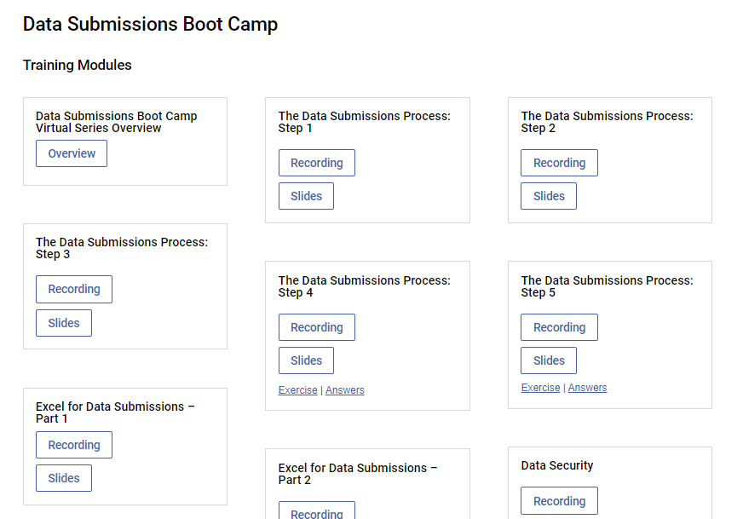
The Data Submissions Process
resources.csi.state.co.us/data-submissions-bootcamp/
2
Notes:
This training is just one element of Step 1 of the Data Submission Process, which focuses on collection prep. If you are a new data submissions contact or a returning contact wanting a review of the data submission process, please review the recent Boot Camp training modules that focus on the Data Submission Process.
The Data Submission’s Boot Camp series can be found under the General Resource section of the main Data Submission Library home page.
.

Slide 3
Purpose of October Count
Collect student data for students in PK-12th grade
Fulfills state and federal requirements
Data collected in Student October is used for:
Determining funding (PPR, ELPA, GT, etc.)
Reports, grants, improvement planning, accountability, etc.
3
Notes:
The October Count data collection serves many purposes.
First, the October Count Collection is a requirement for Colorado public schools based on the Public School Finance Act. Data collected for public school Prek-12th grade students is used to determine the level of funding to provide each school or district based on the count of students and particular special populations to which students may belong.
Additionally, data is used for student demographic reporting and comparisons, grant eligibility, improvement planning, and accountability.
Because of the high-stakes nature of this data collection, it is extremely important that data is comprehensive and accurate. We’ll discuss a variety of resources that can support data quality.

Slide 4
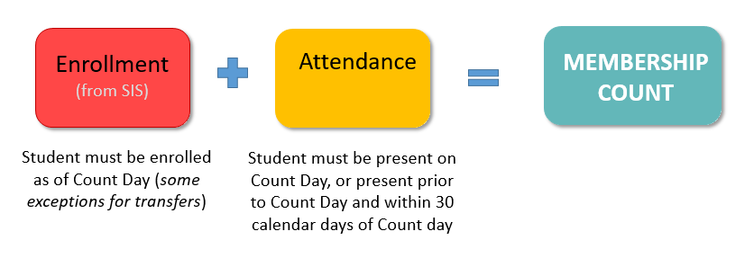
Funding Requirements: Membership
In order to be eligible for funding in the Student October count, students must meet the membership (enrollment and attendance) requirements.
Friday
Oct. 1st
From SIS
4
Notes:
As mentioned, student data collected is used to determine the level of funding that each school receives.
CDE has specific requirements that must be met for students to be eligible for full or part time funding.
In order to be eligible for funding, students have to meet Membership requirements. That is, students must be enrolled and in attendance for Count Day to be eligible for funding. If a student is absent on Count Day, so long as they were in attendance prior to Count Day and within 30 days of Count day, they are likely eligible for funding.

Slide 5
Funding Requirements: Schedule
Once membership requirements are met, funding level is determined based on the student’s scheduled teacher-pupil instruction and contact hours as of the pupil enrollment count date.
5
Notes:
Once the membership requirements are met, then funding levels (full or part time) are based on the student’s scheduled teacher-pupil instruction and contact hours as of the semester pupil enrollment count date.
CDE requires supporting documentation for ‘meeting’ the requirements, so schools must be able to provide documentation to prove that students meet the level of funding schools have submitted in their October Count files. This is covered in more detail in the October Count audit trainings.
At this time, it’s just important to know that students being included in your data reporting should have the appropriate backup documentation to confirm their eligibility for funding.

Slide 6
Timeline
6
Notes:
Let’s discuss the October Count submissions timeline.

Slide 7
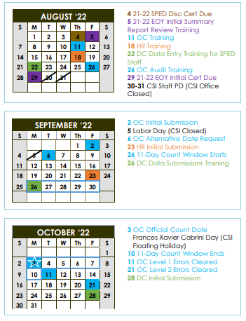
OC Submissions Deadlines
8/11 –Training
9/2 – Initial Submission
9/26-10/10 – Count Window
10/3 – Count Day
10/11 – Level 1 Cleared
10/21 – Level 2 Cleared
11/3 – Certification Due
Access the OC Audit Training details on OC Audit dates
Printable Calendar: resources.csi.state.co.us/data-submissions-calendar/
Online Calendar: www.csi.state.co.us/calendar/
Notes:
At the top of the October Count Resource page is a link to the Data Submission calendar. This calendar is printable and color coded by collection. The October Count and October Count Audit dates are all marked in blue.
As a reminder, you can also access the CSI Online Calendar. The online calendar is updated regularly throughout the year as timelines change. Users can subscribe to the calendar to have deadlines synced to their google calendars.
The October Count is one of the shortest collections, lasting roughly 12 weeks and overlapping with other first semester collections, as well as End of Year wrap up. Given this, it is important to begin reviewing October Count Recourses, which we’ll discuss shortly, as soon as possible in order to say on top of the collection. And, it is important to set internal deadlines for yourself and colleagues to ensure your school is able to meet CSI deadlines.
Key dates for the October Count submissions are listed on this slide.
The initial file submission to CSI is due by September 2nd. Of course, the CSI Data Submissions Team welcomes earlier submissions! Remember, before submitting files to CSI, schools should be using the Record Checker Tool and updating their data as much as possible based on any errors generated in the tool.
Count Day takes place on Monday, October 3rd.
Level 1 errors must be resolved by October 11th and Level 2 errors must be resolved by October 21st. Data should be certified as complete and accurate no later than November 3rd.
These deadlines are specific to the October Count Submissions. For more details on dates associated with the October Count Audit, please review the October Count Audit General Overview Training.

Slide 8
Additional OC Deadlines
Deadline | Task
Sept 6th | Total enrollment count check Deadline to request alternative count date and/or window
Sept 30th | Deadline to submit McKinney-Vento (homeless forms) for approval prior to count day ALP approval deadline for early access students
Due to the critical nature of the deadlines, CSI’s School Compliance Policy will be exercised for missed error clearance deadlines
Notes:
In addition to the October Count submissions related dates, there are other dates that are good to be mindful of. These are not on the calendar because they are not submission dates. Reminders for these deadlines will be included in our weekly emails.
The Initial file submission date is Sept 2nd. Following this deadline , CSI will be running total enrollment checks on the data from all schools, comparing the data to projected enrollment counts that we compiled earlier this year. This is just a data validation check that we like to do to look for any major discrepancies in enrollment. There is nothing you need to do for this step beyond ensuring that you make that Initial Submission Deadline.
As we’ll discuss shortly, September 6th is also the date by which schools can request an alternate count date.
There are also two different deadlines for September 30th
The first is the deadline to submit the McKinney-Vento forms for homeless students and families for inclusion in the October Count data collection. These need to be submitted in September so we have enough time to get approval before the October Count date.
Also on September 30th is the ALPs approval deadline for Early Access students. Kindergarteners who are under the age of 5 are eligible for a maximum of full-time funding if they meet the related state requirements. Because of this, ALPs have to be approved by Sept 30th in order to claim extra funding for those students.
Since the October Count collection has a relatively short turnaround time and the data is used for several high stakes purposes, CSI will utilize the School Compliance Policy for schools missing October Count deadlines.

Slide 9
Alternative Count Date Requests
In rare circumstances, schools can request an alternative count date and/or window
If approved, used for all October Count data, FRL eligibility, and transportation reimbursements
Email requests to submissions_csi@csi.state.co.us no later than September 6th, 2022.
Include desired alternative count date and/or window and rationale
Notes:
As mentioned on the previous slide, schools, in rare circumstances, have the opportunity to request an alternative count day.
This typically is considered for schools that are not in session for Count Day and/or are not in sessions for multiple days within the count window. If you are interested in learning more about whether an alternative count date may be necessary for your school, please email the submissions inbox. If you are requesting an alternate count date, please also include your desired count date and count window and a reason why you are requesting an alternative date.
If an alternative date is approved, all data (including FRL eligibility and transportation data) must be based off of your school’s alternative count date instead of October 1st.

Slide 10
Timeline Considerations
Is your SIS up to date?
Are new fields/codes showing up in your SIS?
Do the SD and SSA files successfully extract from your system?
Do file extracts include data in general, and data for new fields if applicable?
Have you used the Record Checker Tool yet?
Schools should address flags in data from the Tool prior to submitting files to CSI.
10
Notes:
We just reviewed the timeline for the October Count data collection. I want to provide some additional considerations as you think about the preparations needed for the first deadline, the initial file submission.
Is your SIS up to date? You can check by reviewing the vendor’s release notes to confirm whether you are on the latest version. You can also check any fields that have been updated for this school year (which we’ll discuss later in this training). If there’s a new code added to a field, you’ll want to check whether your SIS has that new code available for you to use.
Do the SD and SSA files extract successfully from your system? That is, when you extract a file, is student data coming out or is the spreadsheet blank? Additionally, does the extract include any new fields that have been added for this year’s collection? This is especially important for new schools and new contacts.
Finally, have you used the Record Checker Tool yet? This tool will save significant time during the October Count collection if it is used prior to submitting any files to CSI. If you are new to the Tool, please review the training on the October Count resource page prior to using the tool. Additionally, note that in addition to using the tool to identify potential errors, it is expected that schools are addressing those possible errors in their SIS prior to submitting initial files to CSI so be sure you are building time in to do this before the initial file submission deadline.

Slide 11
October Count Resources
11
Notes:
Now let’s look at resources to help you navigate October Count.

Slide 12
SASIDs and October Count
Every student needs a SASID.
Follow CSI’s SASID training for information on requesting and updating SASIDs.
Request SASIDs and SASID updates as needed and as soon as possible.
https://resources.csi.state.co.us/sasid-edid-requests/
Notes:
One of the highest (and earliest) priorities is to ensure that all students have a SASID. We recognize the beginning of the year is busy, but staying on top of SASID requests and updates is essential for a smooth October Count data collection. While we do occasionally see initial file submissions with missing SASIDs, there is no reason this missing data should persist. If you submit a file with missing SASIDs, the expectation is that you have that SASID filled with your next submission.
If you need a review on how to request SASIDs or SASID updates, please review the SASID resources and trainings on the SASID/EDID webpage.

Slide 13
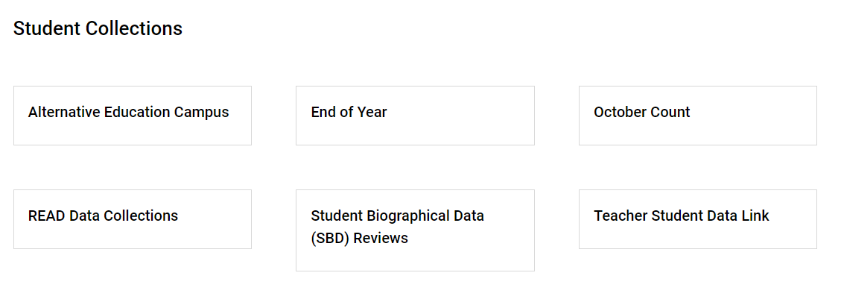
October Count Resources
https://resources.csi.state.co.us/october-count/
13
Notes:
Most of the resources you will need to reference for the October Count Collection will be found on the October Count Resource page on the Data Submissions Library.
The link to the October Count Resource page is at the bottom of the Data Submission Library Home page, under ‘Student Collections.’
To be successful in meeting the October Count collection requirements and deadlines, CSI several trainings and tools. Please take time - as part of Collection Prep, to review these resources. Once this training is concluded, it is highly recommended that you to take 15-20 minutes to navigate to the October Count resource page and click through the resources to get a feel for where they are, how they look, and what information they include.

Slide 14
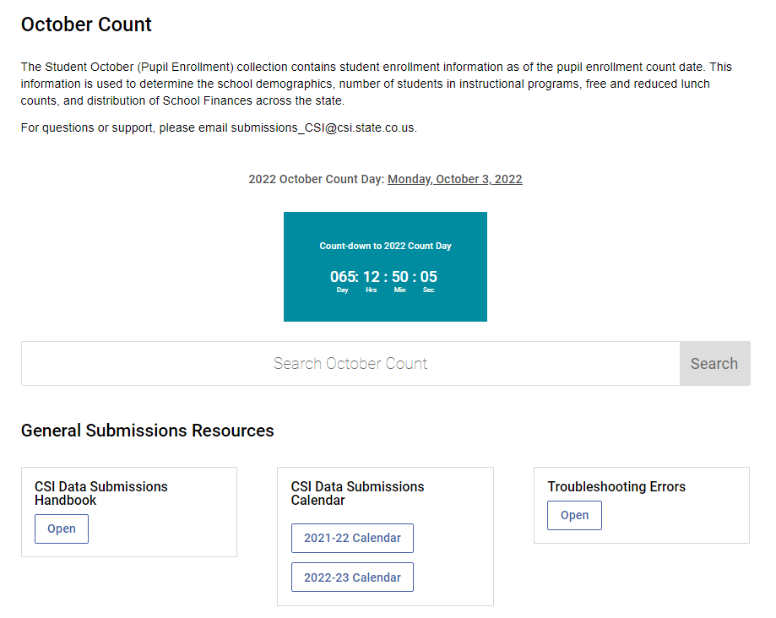
General Submissions Resources
https://resources.csi.state.co.us/october-count/
14
Notes:
The General Submissions Resources provides quick links to frequently accessed resources source as the Data Submissions Handbook, Calendar, and Troubleshooting Errors tool.

Slide 15
File Layouts
October Count: https://resources.csi.state.co.us/october-count/
Boot Camp: https://resources.csi.state.co.us/data-submissions-bootcamp/
Notes:
The next group of resources on the October Count page are the File Layouts.
There are a total of three files that can be submitted for October Count: Title I, Student Demographic, and Student School Association files. While every school will be submitting SD and SSA files, only a handful of schools will need to submit a Title I file and we will be reaching out to those schools individually.
File Layouts can support schools with data collection, data entry, and troubleshooting data errors. If you are unfamiliar with how you can use File Layouts, please access the File Layout training module from the Data Submissions Boot Camp.

Slide 16
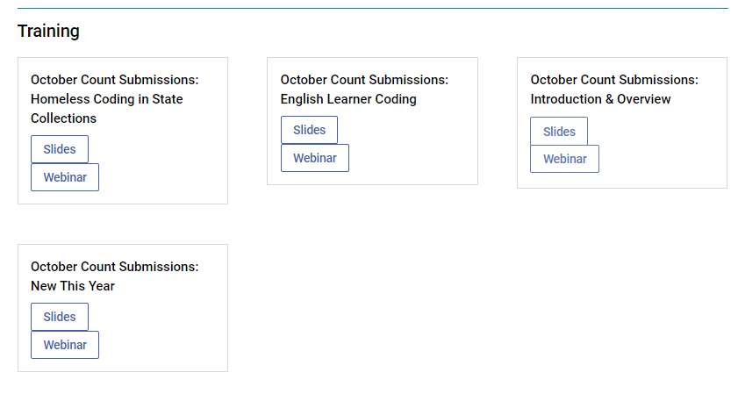
Trainings
https://resources.csi.state.co.us/october-count/
Notes:
In addition to this general overview training, there are several additional trainings available. We will send out an email each time a new training is released, and the Weekly Update will also include notifications on new trainings. These trainings can be reviewed as many times as needed.

Slide 17
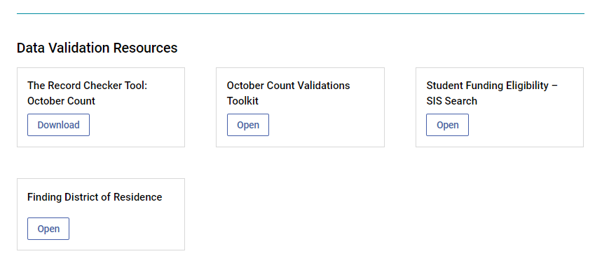
Data Validation Resources
https://resources.csi.state.co.us/october-count/
Notes:
The next group of resources are the data validation resources available to your school, including the October Count Record Checker Tool. Please be sure to review the toolkit and walk through the steps in full before the initial submission deadline.
Additionally, there is a useful validation resource that helps with determining funding eligibility of your students. If you are unsure of how which funding code to use for a student or student population, be sure to check this resource for guidance.

Slide 18
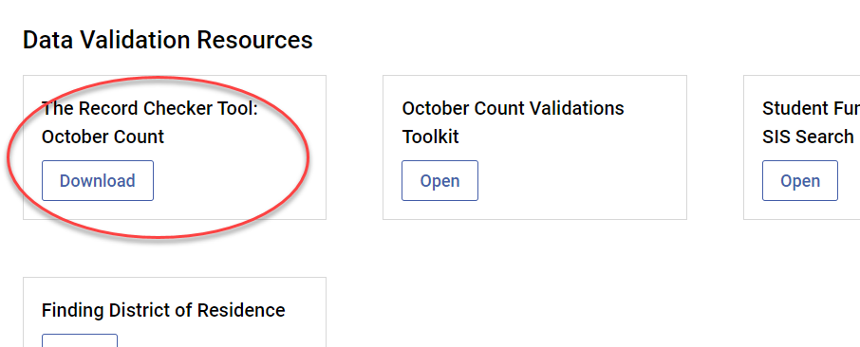
October Count Record Checker Tool
Recommended date to complete a check is August 29th, 2022
Notes:
The Record Checker Tool was mentioned earlier in this module. We want you to be aware that CSI has an updated version specifically for the 21-22 October Count collection and the location on the webpage is shown here. Instructions are directly inside the file itself.
The recommended date from CSI that you complete your check is by August 20th. Please complete it as soon as possible if you can’t make that date and rerun that as many times as you like.

Slide 19
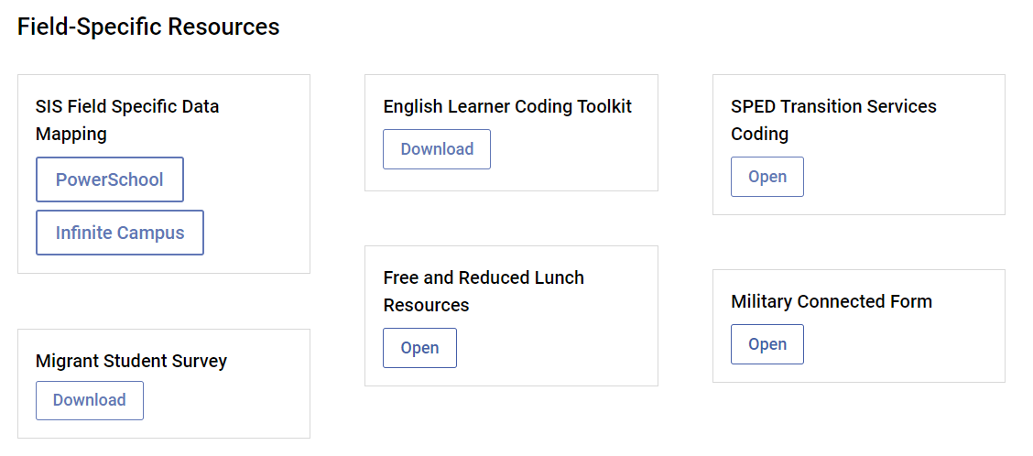
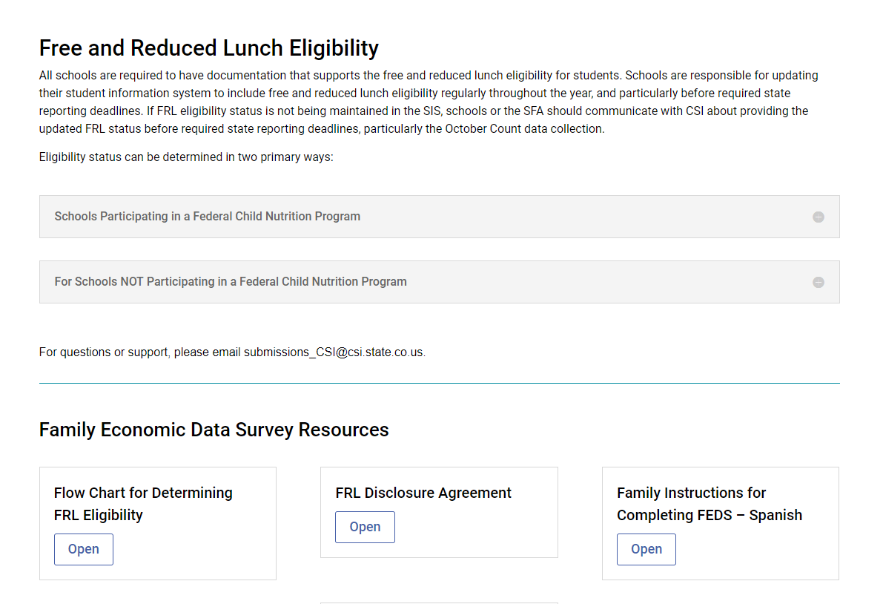
Field-Specific Resources
https://resources.csi.state.co.us/october-count/
Notes:
Another type of resource available to you are field-specific resources, which are specific to special population fields.
Here is a screen shot of the October Count field specific resource section which includes documentation and forms that help with the data entry of specific fields found in the Student Demographic and Student School Association files. This section includes migrant student and military connected forms along with English Learner programs and codes. There is also a link to another resource site that exclusively covers Free and Reduced lunch eligibility and resources.
New this year is the SIS Field Specific Data Mapping resource. This includes links for both Infinite Campus and PowerSchool and navigates users to specific and sometimes harder to find fields within their SIS.

Slide 20
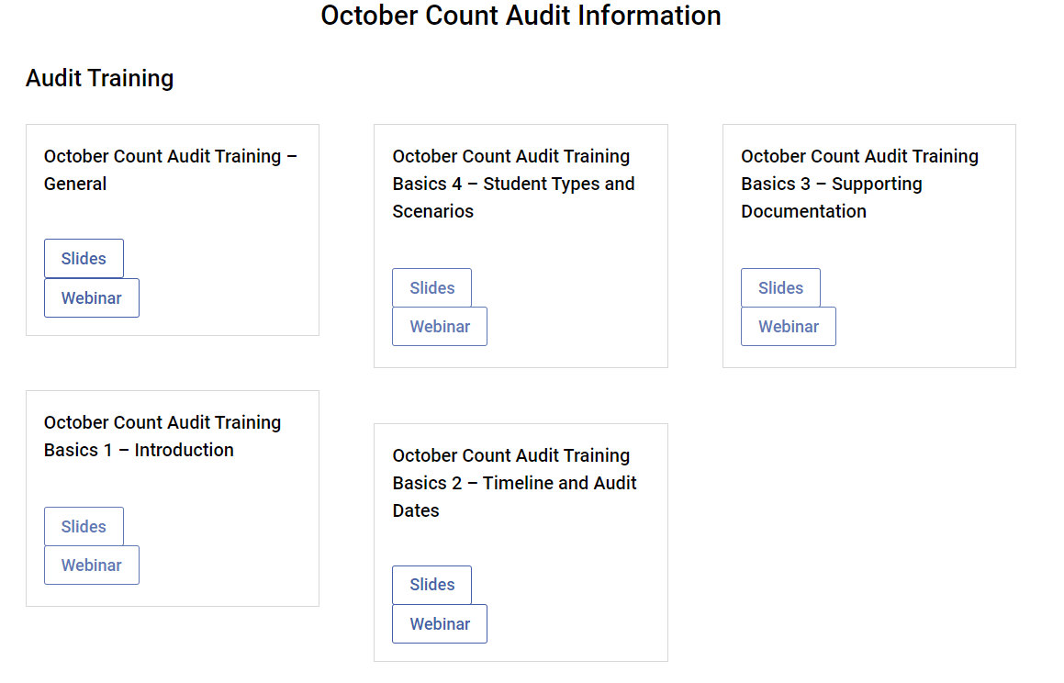
OC Audit Resources
https://resources.csi.state.co.us/october-count/
20
Notes:
The final section of the October Count Resource page is the October Count Audit Resource section. This will be covered in a separate training.

Slide 21
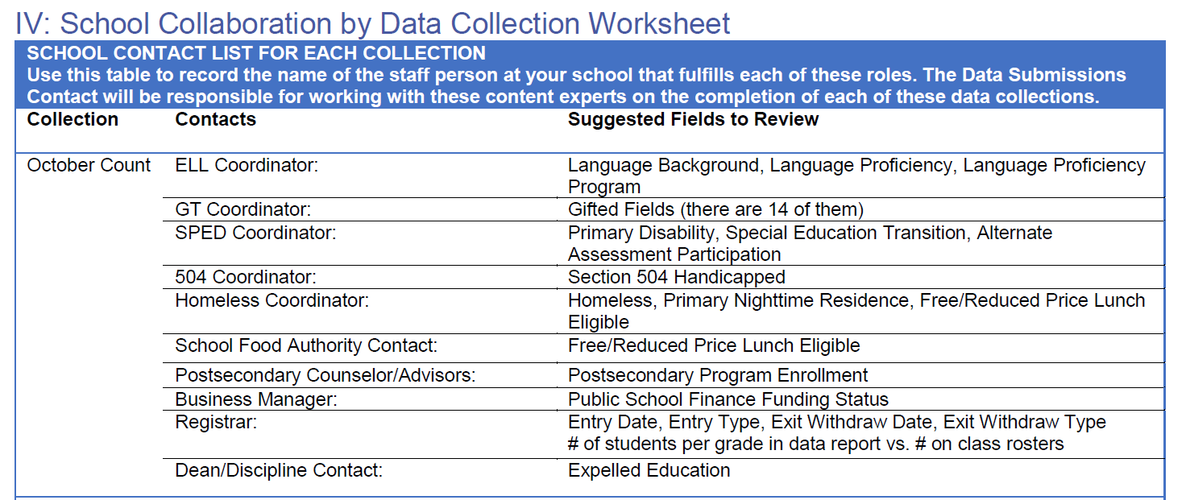
Collaboration is Key
Available in Appendix of the CSI Data Submissions Handbook
21
Notes:
Last but not least, one of the most important resources available to you are the content-experts at your school!
The CSI Data Submissions Team expects school data submissions contacts to be experts in the data submissions process. We expect school data submissions contacts to also work closely with content-experts as their schools in reviewing data for accuracy.
Because October Count collection pulls in a variety of data about students, it is essential that data submissions contacts are working closely with school-level content experts in the collection, reporting, and verification of October Count data.
We’ve provided a list of key types of data in the October Count collection, and particular fields where they can be found. This information is included in the Appendix of the Data Submissions Handbook and identifies that roles at your school that will be helpful to collaborate with during the October Count data collection.
It might be a good idea to go ahead and reach out to the subject experts in your school to let them know that October Count is underway and you will be needing their input and expertise in the coming weeks.

Slide 22
Changes for 2022-23
22
Notes:
Now let’s look briefly at what changes to expect for the 2022-23 data collection.

Slide 23
Updates to the SD File Layout
No new fields
Added field code options:
Postsecondary Program Enrollment
17- Teacher Recruitment Education and Preparation Program. Students enrolled in the TREP program have completed 4 years of high school, returned for postsecondary education following their 12th grade year for their 5th year of high school, and are enrolled in an educator preparation pathway.
This is for retained 12th graders only and students in this program have been granted one of the district’s allocated TREP slots.
Notes:
The good news is that there are minimal updates to the SD and SSA File Layouts this year.
For the SD file, there are no new fields and the only updates are related to existing data elements. Specifically the Postsecondary Enrollment filed has added code 17 for 12th graders returning to participate in a Teacher Recruitment Education and Preparation program.

Slide 24
Updates to the SSA File Layout
No new fields
Updates to existing fields:
Exit Type 92 -Completed (non-diploma certificate) can now also be used for special education transition students who (1) are receiving a non-diploma certificate and (2) will not continue transition services in the following year.
Removed fields:
Independent Study
Non-school program – Code 5 – 100% Remote Learning Option
CSI’s 22-23 Remote Learning Requirements
Notes:
Similarly, there are minimal updates to the SSA File Layout this year. There are no new fields and just a few updates to existing fields.
Exit Type 92 can now be used on 12th grade SPED completers, however this change will not impact October Count but will be relevant for EOY.
Independent Study coding has been removed as has the Non-School Program code of 05 – 100% Remote Learning Option. The removal of this code is due to CDE requirements that districts may only provide temporary remote learning as a result of COVID-19 health concerns. See CSI’s webpage on Remote Learning Requirements for the 22-23 school year.

Slide 25
EL Histories
Create spreadsheet of NEW students who have indicated a non-English language on the home language survey.
SASID
Last Name
First Name
[schoolcode]_[schoolname]_ELHistoricRequest_[mmddyyyy]
Ex: 8001_CSI_ELHistoricRequest_08092022
Cognos Report – English Learner Historic Reporting for Multiple SASIDS
RESULTS – placed in OC Files to Run folder on Gdrive
EL Historic Report is one piece of total ‘body of evidence’ used in EL evaluations
Exception Requests can be made for redesignating an EL student to a new proficiency code
25
Notes:
This year, the Data Submissions Team will be working closely with School Programs and Equity Initiatives Manager Brooke Frarck to try to limit errors around EL Learners.
When a newly enrolled student completes a home language survey that indicates a language other than English is spoken in the home, that student should be added to a spreadsheet that will be created by the school. This spreadsheet only needs to contain the students SASID, last name, and first name. Standard file naming conventions should be applied to this file, with school code & initials preceding “EL Historic Report Request”, followed by the date. Once there are several students on the list, you, as the data submission coordinator, will upload this file to the October Count Files to Run folder on GDrive, being sure to email the submissions inbox, notifying us of a new file to process.
We will then upload the SASIDs to a Cognos report that was created in a joint effort with CSI – the English Learner Historic Report for Multiple SASIDs. We will then upload the resulting file of EL Histories back to your Files to Run folder.
It is important to note that the EL Historic Report serves as just one piece of the body of evidence needed when evaluating a potential EL student.
If an EL coordinator feels strongly that a student should be redesignated to an EL code outside of the logical EL progression then CSI can request an exception for the resulting error and the new EL designation will stand.

Slide 26
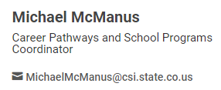
ASCENT
Removal of ASCENT slots - Any eligible student may participate in ASCENT!!
The cap of 500 ASCENT slots statewide is removed.
Therefore, there is no ASCENT allocation model.
Any eligible student may participate in the ASCENT program if they meet eligibility requirements.
ASCENT eligibility - 9 postsecondary credit hours
The number of postsecondary credit hours required to be eligible to participate in the ASCENT program is now 9 (reduced from 12).
ASCENT Funding
Schools should use the Student October Count file as the mechanism to submit funding for ASCENT students.
Districts and charter schools will report to CDE the estimated number of ASCENT participants for the upcoming school year, and CDE will report the total estimated participants to the General Assembly as part of its budget request.
LEPs can no longer require repayment from students who do not complete concurrent enrollment courses or earn a failing grade
The language in 22-35-105(4)(a-c) is now removed.
ASCENT Coding
CDE will host an OC coding webinar in early September. CSI will send out an email with relevant information on how to code ASCENT students.
CDE ASCENT & CE Programs 2022-23 Update
26
Notes:
Thanks to the recent passage of a piece of legislation, ASCENT slots are no longer limited to 500 state-wide. Instead, any eligible student can participate in the ASCENT program if they meet eligibility requirements.
Other changes to the ASCENT program include the reduction of credit hours required from 12 to 9.
Guidance on coding updates for students participating in ASCENT have not yet been released. However, CDE will be hosting a coding webinar in early September. CSI will send out an email of all relevant information around coding for ASCENT students.
In the meantime, if you have any questions, please be sure to visit the CDE ASCENT & CE Programs Update page or reach out to CSI’s Michael McManus.

Slide 27
SPED Transition Retention Coding
EOY Entry
SASID | First Name | Last Name | Entry Date | Grade | Entry Type | Exit Date | Exit Type | Retention
12345678 | Sam | Doe | 08092020 | 012 | 02 | 05092021 | 90 | 3
After SIS rolled over to 21-22 SY
SASID | First Name | Last Name | Entry Date | Grade | Entry Type | Exit Date | Exit Type | Retention
12345678 | Sam | Doe | 08092021 | 012 | 90 | 05092022 | 27 | 3
27
Notes:
Last year, CDE introduced new retention coding for SPED Transition students.
Unlike the other retention codes, this code does need to continue to be on the enrollment record for both October Count and End of Year. So if you used retention code three in the 21-22 EOY collection, you will need to make sure that retention code three is also on the record in 22-23 October Count reporting.
Please note that this exit coding will trigger an error if the student does not have a disability reported on the SD file.

Slide 28
Reminders for 2022-23
28

Slide 29
Data Validation Resources
2
1
Recommended date to complete and submit Record Checker data for CSI review is August 29th, 2022
https://resources.csi.state.co.us/october-count/
Notes:
The two validation tools you will want use prior to your initial submission are first the October Count Validations Tool kit and then the Record Checker Tool.
The October Count Validations Toolkit will help walk you through identifying and checking special population groups such as McKenny Vento, EL learners, ASCENT students, and more.
The Record Checker Tool will help you identify potential errors. If you would like the Data Submission Team to review your Record Checker data, please upload the file to your October Count Files to Run folder and send an email to CSI.
If you are a new Data Submissions contact or a Tier Two School, you will want to submit your Record Checker Tool by August 29th for review.

Slide 30
SSA File Layout – Attendance Reminder
All attendance fields should be populated accurately!
This helps to ensure your SIS is set up correctly at the beginning of the year.
Notes:
One of the errors the record check will help you identify is if your Attendance data is populating correctly. While Attendance Data is not used until the end of the year process, it is a CSI requirement that all schools have attendance properly set up at the beginning of the school year. Be sure to check that Attendance is extracting correctly before submitting your first file.

Slide 31
SIS Audit
Data Submission Team has begun auditing
See email from Janet Dinnen on August 2nd about ‘Reminders and Updates’ for your SIS (PowerSchool or Infinite Campus)
Please see the Data Management Systems page on the Data Submission Library website
IC System Set Up Audit
Colorado’s PowerSchool State Reporting Setup
31
Notes:
To help ensure correct SIS set-up, the Data Submission Team will be auditing your SIS from now until August 19th.
We will let you know if we find anything that needs updating, however you can be proactive in the task by review the “SIS Reminders and Updates” email sent by Janet Dinnen on August 2nd. If you did not receive this email, please reach out and we will forward it to you.
While the email contains many tips and resources on SIS upkeep best practices you’ll want to be sure to review the materials on CSI’s Data Management Systems website, paying close attention to the IC Set Up Audit or the PowerSchool State Reporting Set up guide – depending on which SIS you use.

Slide 32
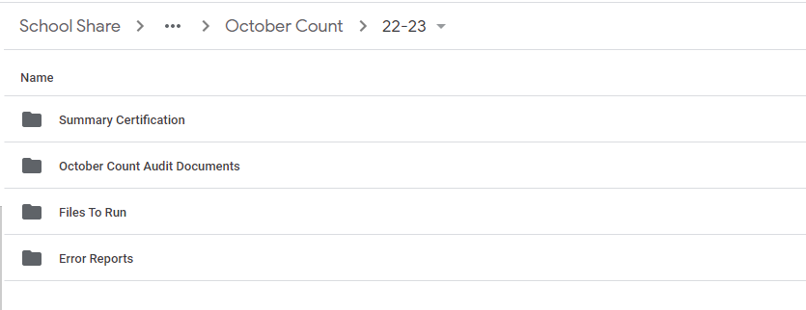
GDrive
32
Notes:
And as a final reminder, CSI is no longer using FileZilla for file transfers. We have fully shifted to GDrive and all school data submission contacts have been granted access. If you are unable to access your schools folder on GDrive, be sure to check first that you are not using your personal Google Account.
If you continue to have issues with access, please reach out the submission’s inbox for assistance.

Slide 33
Best Practices & Helpful Hints
Collaborate with colleagues
Keep up with SASID requests and updates
Add OC dates to your work calendar
Contact the subject area experts of your school
“Heads up OC is kicking off”
Verify data and resolve issues
Search RITS for existing SASIDs
Request new SASIDs or Updates a.s.a.p.
No reason SASIDs should be zero-filled past initial submission
Add all October Count deadlines
Work calendar
Shared school calendars
Set dates earlier
33
Notes:
Some final thoughts as we wrap up the October Count General Overview Training.
First, it’s extremely important to collaborate with the content experts at your school. Take time to introduce yourself, let them know the collection is kicking off, and let them know that you’ll be leaning on their expertise to verify data and resolve issues.
Second, keep up with SASID requests and updates. For new students to your school, check whether there is already a SASID for them in the RITS system and request one if there isn’t. While we recognize there may be times when students have missing SASIDs in the initial file submission, it is expected that those particular errors are resolved prior to the next submission.
Finally, make sure you have a system that works for you for staying on top of the various deadlines associated with the collection. Add deadlines (or even set earlier, internal deadlines) to your calendar. Share deadlines with colleagues that you’ll be collaborating with.
These practices will support you in a smooth October Count data collection process.

Slide 34
Thank you for reviewing this training!
Contact the Submissions Inbox with Questions:
Submissions_CSI@csi.state.co.us
34
Notes:
Thanks so much for reviewing this training! If you have questions on any of this information, please reach out to the CSI Data submissions inbox. Have a great day!

