Slide 1
Specific Learning Disability
IEP Amendment
August 10, 2020

Slide 2
Objectives
Participants will be able to understand when it is appropriate to complete IEP Amendments
Participants will understand Significant Change of Placement Considerations

Slide 3
When is it Appropriate to Amend an IEP?
Lack of Progress Towards Annual Goals
New information about the child is provided by the parent/guardian
Reconsideration of decisions previously made regarding grading, promotion, assessment;
The need to eliminate or add curriculum, modifications or accommodations such as classroom or individual aids
Notes:
The current definition includes a student who has a full scale score of 2.0 standards deviations. Previously, if they were at 2.0, they would not qualify for services under intellectual disability. This change will assist teams with identification of students who are in the border line range of intellectual disability. This criteria aligns with the DSM-IV-TR.
Remember, this score, in and of itself does not deem a student eligible for this category.
SEM – standard error of measurement

Slide 4
When is it Appropriate to Amend the IEP Continued:
Revision or consideration of a behavior intervention plan
The need to identify alternative strategies to meet transition objectives if those set forth in the IEP are not being provided
Clerical Mistakes within the IEP

Slide 5
Amending the IEP using IEP Amendment
Definition of a Non-significant Change in Placement: When a child’s Special Education Program is altered, such as a change in the amount of service, the change in program/services in non-significant change in placement. Prior written notice of such changes must be provided to the parent, but consent and re-evaluation is not required. A nonsignificant change in program/services must be made by the IEP team unless the parent and administrative unit/state operated program mutually agree to change the IEP after the annual IEP meeting in a school year. -CDE IEP Procedures Manual, Page 47
Examples of a Non-significant Change of Placement:
Revisions to objectives for Annual Goals
Revisions of the Behavior Intervention Plan
Add or eliminate a curriculum modification or accommodation
Notes:
The level of independent adaptive behavior is significantly below the culturally imposed expectations of personal and social responsibility. The body of evidence shall include results from each of the following:
This is a big change from our past practice. A parent interview must be included but the parents score is not a single determining factor.

Slide 6
Significant Change in Placement
All other Changes to the IEP are identified to be a significant change of placement. According to CDE’s IEP Procedural Manual, “A significant change in placement shall be made upon consideration of reevaluation. Such change shall be made only by an IEP team with the addition of these person’s conducting such a reevaluation…”

Slide 7
Examples of Significant Change of Placement Includes
Placement or Referral to Private School or approved facility
The addition or termination of instructional or related service
Any Change that results in:
The Child having different opportunities to participate in non-academic and extra curricular services
A change in educational environment categories or LRE
A Transfer to or From a brick or mortar school to an online program
A significant change in placement shall be made with consideration of reevaluation, and by the full IEP team including persons conducting the reevaluation

Slide 8
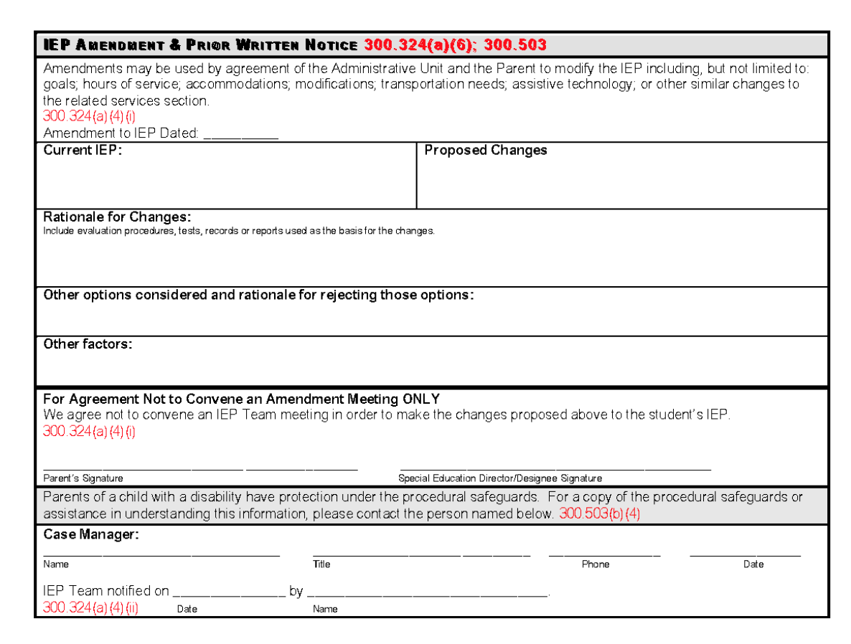

Slide 9
Amendments do not reset the clock
Anniversary date of the Annual IEP Review will remain the same when an amendment is completed
Teams must follow timelines of Re-evaluation due dates

Slide 10
Resources
IEP Procedural Guidance: Exceptional Student Services Unit Technical Assistance; Colorado Department of Education
http://www.cde.state.co.us/cdesped/iep_proceduralguidance
CSI Special Education Coordinator
CSI Special Education Director
Matt Hudson: matthudson@csi.state.co.us

