Slide 1
Colorado’s Student Data Transparency and Security Act
CSI Regional Meeting
Winter 2017

Slide 2
In Short:
Contract;
Policy; and
Posting requirements for:
School Service Contract Providers
On-Demand Providers

Slide 3
Resources
http://www.csi.state.co.us/school_resources/legal_policy/guidance_and_resources
https://www.cde.state.co.us/dataprivacyandsecurity/newprivacylawresources
https://tech.svvsd.org/studentdataprivacy/

Slide 4
But first…
Step 1: Is it a “school service”?
A website, online service, or app that is
  (i) designed and marketed primarily for use in a pre-k, elementary, or secondary school;
  (ii) used at the direction of teachers or other employees of the school; and,
  (iii) which collects, maintains, or uses Student Personally Identifiable Information (“Student PII”).
Notes:
The regulations only apply to two types of vendors: School Service Contract Provider or an On-Demand Provider

Slide 5
But first…
Step 2: If so, is it a School Service Contract Provider or an On-Demand Provider?
School Service Contract Provider: An entity, other than a Public Education Entity (CDE, CSI, another public school, a school district, a BOCES) or an Institution of Higher Education, that enters into a formal, negotiated contract with a Public Education Entity to provide a School Service.
E.g., Google Apps for Education, Infinite Campus or PowerSchool, or Edgenuity
Notes:
A “School Service” is a website, online service, or app that is (i) designed and marketed primarily for use in a pre-k, elementary, or secondary school; (ii) used at the direction of teachers or other employees of the school; and, (iii) which collects, maintains, or uses Student Personally Identifiable Information (“Student PII”).

Slide 6
But first…
Step 2: If so, is it a School Service Contract Provider or an On-Demand Provider?
On-Demand Provider: An entity, other than a Public Education Entity, that provide a school service on occasion to a school, subject to agreement by the school or one of its employees to standard, non-negotiable terms and conditions of services established by the On-Demand provider.
On-Demand providers do not require a formal, negotiated contract
Think of an app that provides a school service that can be downloaded by a teacher that asks a teacher to click to agree with the vendor’s Terms of Service

Slide 7
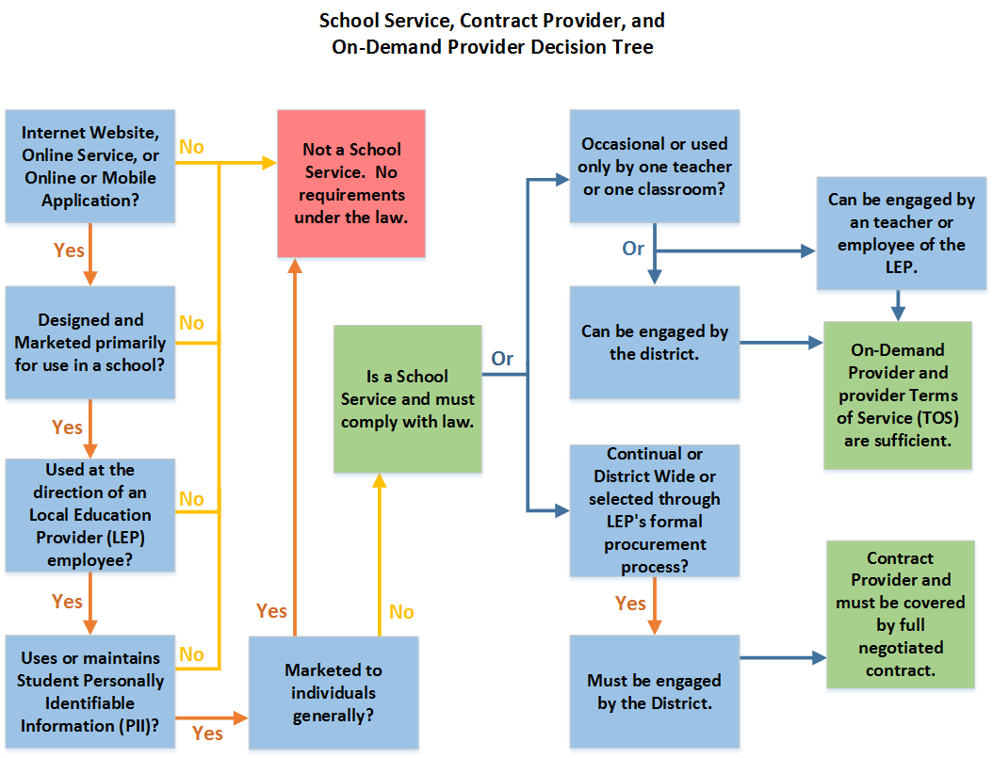
Service Providers under Colorado Law
Notes:
School Services:
An internet website, online service, online application, or mobile application
Designed and marketed primarily for use in a K-12 school
Used at the direction of employees of an LEP
Collects, maintains, or uses Student PII
Does not include a service that is designed and marketed for use by individuals or entities generally, even if it is also marketed to a school
School Service Contract Provider
An entity that enters into a formal, negotiated contract with a LEP to provide a School Service
School Service On-Demand Provider
An entity that provides a School Service on occasion to standard, non-negotiable terms and conditions of service established by the provider

Slide 8
Part 1: Contract Requirements
Beginning Aug. 1, 2016: All contracts entered into or renewed with a School Service Contract Provider
1. Data Transparency Requirements
2. Use of Data
3. Data Security and Destruction
Notes:
Data Transparency Requirements
The Contract Provider must provide clear information to the school explaining (i) the data elements of Student PII that it collects, whether it is collected upfront or ultimately held in the aggregate; (ii) the learning purpose for which it collects the data; and (iii) how it uses and shares the Student PII. This information should be easily accessible through a website, and the school must post the information on its website (more information on posting requirements is provided below).
The Contract Provider must provide notice to the school prior to making any material changes to its privacy policy for school services.
The Contract Provider must provide access to and correction of any factually inaccurate Student PII that is requested by the school.
If the Contract Provider discovers misuse or unauthorized release of Student PII by the Contract Provider, one of its subcontracts, or a subsequent subcontract, the Contract Provider must notify the school as soon as possible, regardless of whether the breach is material.
Use of Data
The Contract Provider can collect, use, and share Student PII only for the purposes authorized in the contract, or with the consent of the student or parent.
The Contract Provider must obtain the consent of the student or parent before using Student PII in a manner that is inconsistent with the Contract Provider’s privacy policy or the contract with the school.
The Contract Provider cannot:
Sell Student PII;
Use or share Student PII for purposes of targeting advertising to students;
Use Student PII to create a personal profile of a student other than for supporting purposes authorized by the school or with the consent of the student or parent.
The Contract Provider can use or disclose Student PII consistent with HB 16-1423 but must notify the school as soon as possible after the use or disclosure.
The Contract Provider can use or disclose Student PII to a subcontractor only if it contractually requires the subcontract to comply with the same requirements of HB 16-1423.
Data Security and Destruction
The Contract Provider must maintain a comprehensive information security program designed to protect the Student PII.
If a school requests destruction of a Student’s PII during the term of the contract, the Contract Provider must destroy the information as soon as practicable after the date of the request unless it obtains the consent of the student or parent or the student has transferred to another school and the other school requests that the information be retained.
Following the termination or conclusion of the contract, the Contract Provider, within the time period specific in the contract, must destroy all Student PII collected, generated, or inferred as a result of the contract. If the contract does not specify a time period for destruction, the Contract Provider must destroy the information when it is no longer needed for the purpose of the contract. The Contract Provider must notify the school of the date that it destroys the Student PII.

Slide 9
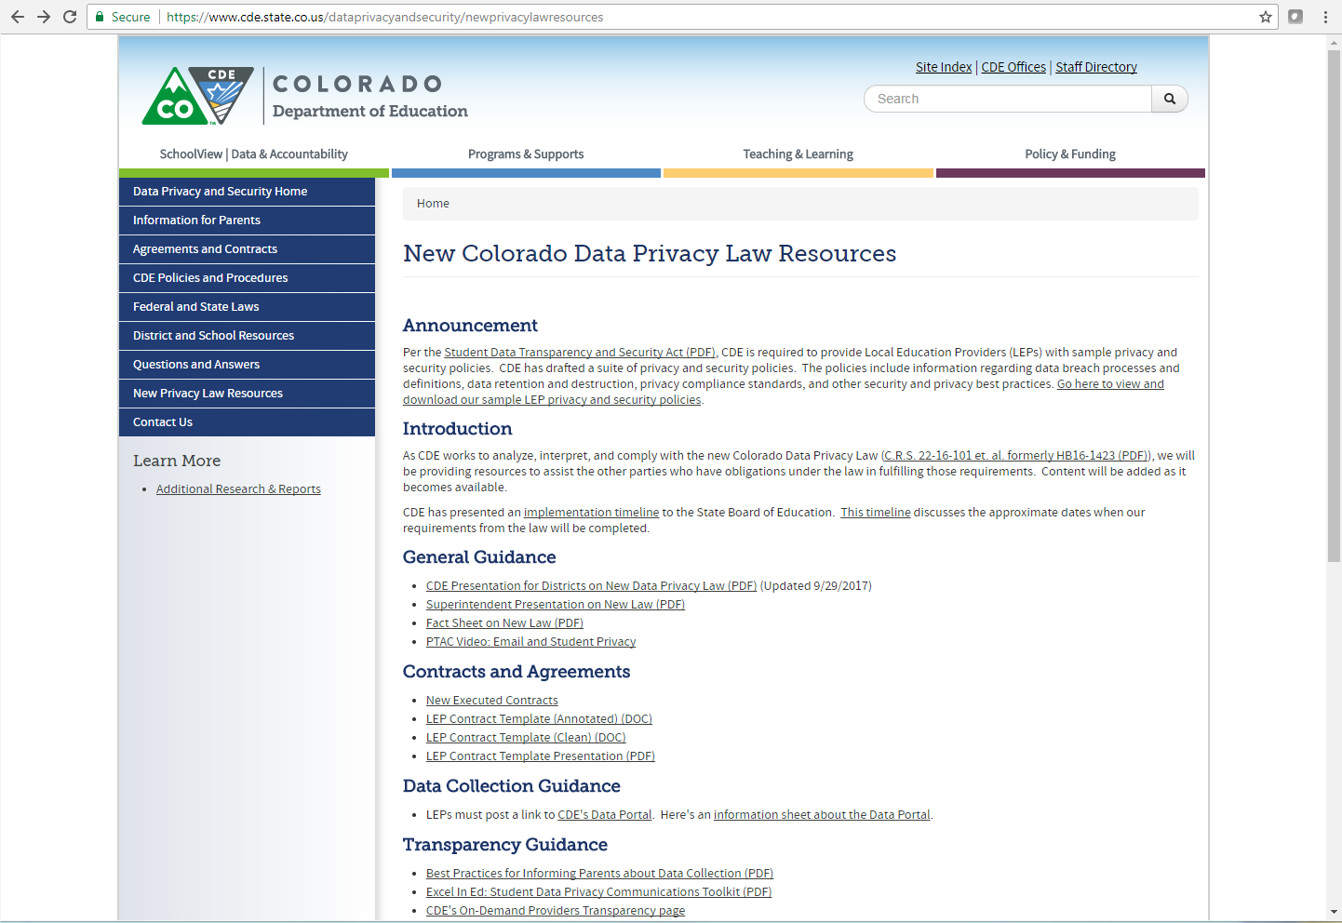
Sample Contract

Slide 10
Part 2: Online Posting Requirements
Clear information explaining the data elements of Student PII that the school collects and maintains in its data system (not including the Student PII that it transmits to CDE) + how the school uses and shares the Student PII.
Link to the index of data elements that the state board publishes: http://www.eddataportal.info/cde
List of the Contract Providers + Copy of Each Contract
The information from the Contract Provider regarding the data elements of Student PII it collects, the learning purpose for which it collects it, and how the Contract Provider uses and shares the information. The Contract Provider must provide this in a format that is easily accessible through a website, and the school must post this information.
The school’s current Student Information Privacy Protection Policy.

Slide 11
Part 2: Online Posting Requirements
If using any On-Demand service providers:
  List of the On-Demand providers used
    List must be updated at the beginning and mid-points of each school year.
  A list of any On-Demand providers that it ceases using or refuses to use because the On-Demand provider fails to abide by state law:
    Failure to comply with its own privacy policy;
    Sells Student PII for an impermissible purpose, uses or shares Student PII for purposes of targeted advertising to students, or uses Student PII to create a personal profile of a student for purposes outside the contract or without consent; or,
    Fails to maintain a comprehensive security program to protect Student PII.
    The school must also post any written response from the On-Demand provider after it has been notified it will no longer be used.
  A notice to On-Demand providers that, if the school ceases using or refuses to use an On-Demand school service provided for the reasons set forth above, the school will post on its website the name of the On-Demand provider, with any written response received, and will notify the CDE, which will also post on its website the On-Demand provider’s name and any written response (this information, along with information about how to send this information to CDE, will be posted on CDE’s On-Demand Provider Transparency page).
Notes:
List must be of any ODPs by the school or school employee

Slide 12
Live Tutorial
https://tech.svvsd.org/studentdataprivacy/

Slide 13
Part 3: Policy Requirements
Creating and maintaining a student data index;
No sample but may be as simple as outlining all of the online posting requirements.
School will post, on its website, clear information explaining the data elements it collects/maintains, how the school uses and shares the Student PII, etc. . . . (discuss all posting requirements)
See also, CDE Data Governance and Transparency Sample Policy

Slide 14
Part 3: Policy Requirements
Retention and destruction of Student PII;
Should address what info is encrypted, how Student PII is stored, how long it is retained, and destroying Student PII.
See also, CDE Sample Policies: Data Encryption; Data Retention; Data Destruction and Sanitization

Slide 15
Part 3: Policy Requirements
Using Student PII for purposes internal to the school;
Should address security in collecting and storing information; monitoring security of Student PII; what information can/cannot be shared or accessed by others
See also CDE Sample Policies:
  Data Governance and Transparency
  Student Data Collection
  Security Monitoring
  Data Privacy
  Securing Sensitive Information

Slide 16
Part 3: Policy Requirements
Preventing breaches in the security of Student PII (not just as it relates to third-party vendors);
Any breaches, not just vendor breaches
See also CDE Sample Data Breach Policy
Notes:
The CDE Sample Policy is very comprehensive and I think quite useful for responding to breaches; but, there really isn’t much out there discussing prevention of breach. This would really be more through your auditing and oversight.

Slide 17
Part 3: Policy Requirements
Responding to any security breaches that occur (all breaches, not just vendor);
  School Service Contract Provider Breach: Policy must require board, w/in reasonable time after school identifies a material breach, to hold a public hearing. Hearing must include discussion of the nature of the material breach, an opportunity for the Contract Provider to respond, public testimony, and a decision as to whether to direct the school to terminate or continue to contract.
  On-Demand Provider Breach: Policy must include procedures for when school receive evidence that an On-Demand Provider does not (i) comply with its own privacy policy; (ii) sells Student PII for an impermissible purposes, uses or shares Student PII for purposes of targeted advertising to students, or uses Student PII to create a personal profile of a student for purposes outside the contract or without consent; or, (iii) fails to maintain a comprehensive security program to protect Student PII.
    Procedures should address: (i) whether to cease using the On-Demand Provider; (ii) notifying the On-Demand Provider that it is ceasing or refusing to use its services; (iii) providing the provider an opportunity to respond in writing; and, (iv) posting this information on the school’s website and notifying CDE.
  See also, CDE Sample Data Breach Policy + CDE On Demand Provider Website
Notes:
Switch to Student Information Privacy and Protection Policy: Public Hearing and Complaint Procedures
Downside is that this policy only seems to address a breach by a school service contract provider and not breaches on a whole, or ODP breaches. You can just go through the ODP language in your policy.

Slide 18
Part 3: Policy Requirements
Contracting with School Service Contract Providers and using school services provided by On-Demand Providers
  Must include statement that school will not enter into or renew a contract with a Contract Provider that refuses to abide by the required contract terms/requirements
  Should address requirements for posting the requisite information
  Consider laying out your procedures
Notes:
Switch back to regular St. Vrain Policy. Their policy could be more clear on the statement that the school will not enter into or renew…

Slide 19
Part 3: Policy Requirements
Disclosing Student PII to Contract Providers, On-Demand Providers, or other third parties
Should address the info a vendor can/cannot access; vendor responsibilities and internal controls, what can/cannot be outsourced to a third-party vendor; adherence to contract requirements
See also, CDE policy on Vendor Access; Outsourcing; Third Party Contracts
Notes:
The St. Vrain Policy just barely touches on this so the CDE policies may come in helpful here

Slide 20
Part 3: Policy Requirements
Notifying parents re: collection, retention, and access to Student PII
E.g., the information that is collected, who can access it, etc.
Can reference your online posting
See also, CDE sample policy on Data Governance and Transparency

Slide 21
Part 3: Policy Requirements
Notifying parents of rights re: Student PII maintained by the school and the complaint policy*
Parents have right to inspect/review Student PII; request corrections to Student PII; right to request paper or electronic copy of Student PII, including that which is maintained by Contract Provider
Complaint policy must provide parents the opportunity to submit written information to school’s board and receive a hearing; board must take action on the complaint w/in 60 days
Notes:
I actually think the complaint policy goes a little overboard
School must provide electronic copy if it is requested unless it does not maintain that Student PII electronically and reproducing it in electronic format would be unduly burdensome

Slide 22
Step 3: Policy Requirements
Providing training in information security and privacy to employees of school;
What training is provided, who is providing it, who must attend, topics covered
See also, CDE sample policy Security Training
Notes:
revisions as necessary to stay current and adequately protect Student PII in light of advances in data technology and dissemination;

Slide 23
Step 3: Policy Requirements
Requiring school’s board to annually review the Student Information Privacy and Protection Policy and make revisions as necessary;
Simple statement that the board will review the policy annually and make revisions as necessary to stay current and adequately protect Student PII in light of advancements in technology

Slide 24
Step 3: Policy Requirements
Addressing that the school will make copies of the policy upon request to a parent + will post on school’s website.
Simple statement that the school will make copies of the policy upon request to the parent of an enrolled student; and will post the policy on its website

Slide 25
Timelines for Required Tasks
August 10, 2016
LEPs must update any contracts with Contract Providers entered into or renewed after this date
December 31, 2017
Each LEP shall adopt a Student Information Privacy and Protection Policy
July 1, 2018
Each LEP that is a Small Rural
School District shall adopt a Student
Information Privacy and Protection Policy
Tip:
The additional time for small rurals only applies to the privacy policy.
All other tasks in the law have no specific due date, but you should be working towards compliance.
Notes:
August 10, 2016 – LEPs must update any contracts with Contract Providers entered into or renewed after this date
December 31, 2017 - Each LEP shall adopt a Student Information Privacy and Protection Policy
July 1, 2018 - Each LEP that is a Small Rural
School District shall adopt a Student
Information Privacy and Protection Policy
If you haven’t done this, you need to, but no need to panic
Real look at the risks of non-compliance.
We have resources to assist you with these obligations that are listed at the end of this module.
One caveat to mention: Given my delay in getting additional training and resources out to schools, I have set the due date for first draft of policies as Dec. 15th. I will review them, provide feedback, and then schools are required to submit revised drafts to me by Jan. 19 and then submit them to their boards for approval. I will go over this timeline later in the slides, but to be completely transparent, part of my thinking is that if anyone came down on one of our schools for not having the policy adopted yet, I would argue that our school should be treated the same as small rural districts given that almost all of them serve fewer than 1,000 students.

Slide 26
CSI Next Steps
Dec. 15, 2017: Submit 1st draft of policy + completed compliance checklist in Totara
  Opportunity for questions/work time at regional meeting
  CSI will review for compliance
Jan. 19, 2018: submit 2nd draft of policy in Totara
Seek board approval
Notes:
Note: CSI’s review will solely be for purposes of ensure that all required components have been met; School should work with their data experts to ensure that your policies and practices make sense for you.
CSI did not create a sample policy. I looked into it, but given the variances in each school’s student data systems, it is difficult to create a sample policy that would meet each school’s needs. I would suggest referencing the suite of template that CDE has.

Slide 27
CSI Next Steps
Maintain online posting requirements
Maintain contract requirements
Maintain policy requirements

Slide 28
Contact
  Trish Krajniak, Dir. of Legal and Policy Initiatives, CSI
  303.866.6960
  trishkrajniak@csi.state.co.us

