Slide 1
New This Year: 2019-20 End of Year
2019-20 End of Year Training: What’s new
Notes:
Welcome to the 2019-2020 End of Year Collection Training.
This presentation is designed for seasoned Data Submissions veterans who are amply familiar with the End of Year Collection and simply need to know what changes are in effect for this year’s collection.
Other Submission contacts are more than welcome to review this training, but please do so after reviewing the General Overview Training.
All of the information in this presentation is repeated in the other End of Year trainings which are designed to be more in-depth.

Slide 2
New this year:
Collection Dates
Attendance Requirements
CSI Data Check Macro
Topic focused training
Dealing with EL Errors
Updates:
Graduation Guidelines
Reminders
Notes:
A short overview of what is in this presentation:
A reminder on collection dates – this will be quick as Data Submission Coordinators should have all collection dates already marked or have a Data Submissions calendar they refer to often.
There are new attendance requirements for this year’s collection. This presentation will touch on some basics but there is/will be a separate in-depth training posted on Attendance Fields that all schools are highly encouraged to review.
We have also developed a new data check tool to assist in lowering initial error counts, and we are testing out a new approach to training modules in this collection.
And finally, there are few updates to cover on Graduation Guidelines as well as a few points of information that are not new, but good refreshers as the collection begins.
So, moving on…

Slide 3
Collection Dates
March 9th – Initial Submission
June 10th – Level 1 Errors Cleared
July 14th – Level 2 Errors Cleared
Early August– Summary Report Review Training (required for all schools)
Late August – Initial Certification Due
Early November – Final Certification Due
Notes:
won’t read through the deadlines here as they are posted in many places throughout the Data Submissions resources.
As many of you are likely aware, the End of Year collection cycle overlaps with the 20-21 collection cycle. Dates for the initial and final summary report EOY certification will be included in the 20-21 Submission calendar.
In the meantime, take a look at this timeline and consider where the date of rolling your SIS over into the new school year falls in relation to End of Year markers. Keep in mind that updating 19-20 school year data becomes much more difficult after you’ve rolled over to the new school year, so be sure to be ahead of End of Year deadlines as much as possible prior to rolling your SIS over to the 20-21 new school year. It is very possible, and highly recommended, to have all Level 2 Errors cleared before you roll your SIS over to the new school year.

Slide 4
New: Attendace Fields (required)
Notes:
Moving on to attendance fields….

Slide 5
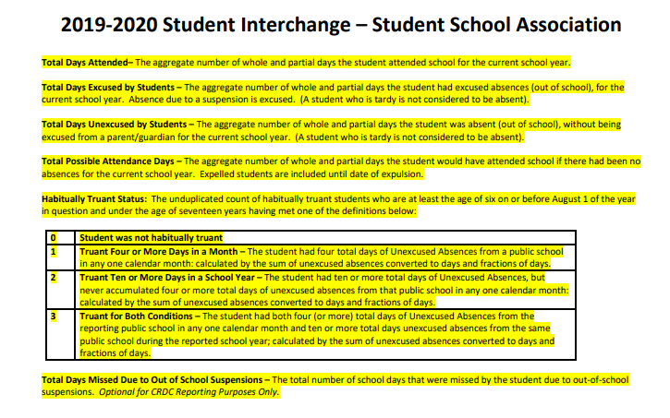
Attendance Requirements
Complete and accurate attendance data is required for all CSI schools.
Notes:
As you may recall from Boot Camp and October Count, 6 attendance fields have been added to the SSA file. Field definitions and coding information can be found in the SSA File Layout.
During October Count the accuracy of data in these fields did not trigger errors, since there was nothing to compare the data to. However, collecting this data for the End of Year collection will establish the baseline for future collections, and we will see these fields triggering errors. To help schools reduce Attendance Field Errors we have created a more in-depth training module on the topic.

Slide 6
Attendance Overview
Aggregate to Individual
Notes:
In the meantime, some important things to know:
Previously, attendance data was collected at the aggregate school level but is now being collected at the individual student level for the purpose of use in the Civil Rights Data Collection. This means that, as always, data accuracy is very important.
Because this data will be used to populate areas of the Civil Rights Data Collections, we at CSI are making accurate and complete reporting of all attendance fields a [click] requirement for all CSI schools.
Keep in mind that these fields may become much more difficult to update after your SIS roll-over, so be sure to pay attention to the accuracy of this information early on.
Please review a forthcoming Attendance Fields Training for more in-depth information on the topic.

Slide 7
New: Initial Submission File Check Template
Notes:
Next I’ll be discussing a new validation tool we’re rolling out to help schools reduce errors.

Slide 8
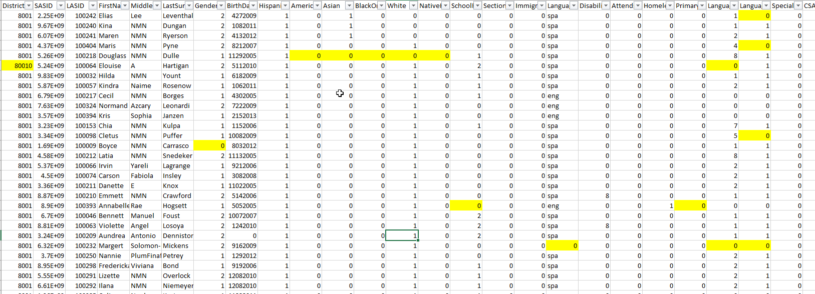
Interchange Files Check Template
Please try me.
SD File Checks Tab
SSA File Checks Tab
Notes:
In addition to the usual SD and SSA Data Validations Checklist, CSI is implementing a new validation tool in the form of an Excel Template. Currently, links to this tool and training are found on the End of Year Collection website.
This validation tool highlights areas of your data that will trigger errors, so you can make the fix in your system prior to your initial submission.
This tool is designed to significantly reduce initial errors, which is why we are making it a requirement for all schools prior to initial submission, as we are eager to see it’s potential in real-world application. This will help us design and cultivate more tools as we continue to work toward our goal of reducing initial error counts for all schools.
Training, instructions, and a link to the tool are on End of Year Collection webpage under the Validation Tools heading. We recommend using this tool at a minimum of two weeks prior to initial submission. This tool is an extension, not a replacement, of our other validation resources.
We will be requesting your feedback in the form of a survey later in the collection and we look forward to hearing what you think about it!

Slide 9
New: Dealing with EL Errors

Slide 10
EL Errors
Jessica Welch: 303.866.2366 JessicaWelch@csi.state.co.us
Notes:
While EL errors common in October Count, we don’t expect to see many EL Errors on the End of Year collection since the EL data should not have changed between October Count and End of Year.
In an effort to reduce EL Errors across all schools, the Data Submission Team will be working with Assessment Team member Jessica Welch. Jessica frequently works with schools on ACCESS testing and is familiar with all the ins and outs of English Language Learners, WIDA, and ACCESS testing. She will be reaching out to schools who have EL Errors.

Slide 11
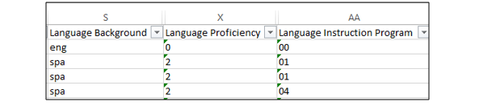
Consistency between OC and EOY
EL FIELDS STAY THE SAME
ACCESS Testing
SIS rollover to 20-21 SY
Update EL status based on ACCESS testing
Updates from ACCESS testing should not be made until after your SIS roll-over to the new 20-21 school year.
Notes:
One common reason we see errors on EL students is due to mid-year EL changes.
So this is just a quick reminder that, unless data was misreported in October Count English Language Learners should not have a change in Language Proficiency or EL Program since October Count. EL scores from ACCESS testing should not be entered until after your SIS has been rolled over to the 20-21 school year. EL Errors are expected on recent transfers, but there should be no EL changes on students who have been with you since October Count.

Slide 12
Update: Graduation Guidelines

Slide 13
Graduation Guidelines
Required from all schools with grades 9-12
(This will be the last test year—go live in 2020-2021)
Initial files can be submitted after March 9th
CSI will provide a training module just for GG
Both IC and PS have report extracts in place
Expect mid year tweaks to IC and PS
Heads up for 2020-2021: Exit type “90” in EOY will be checked against the GG data on record
Notes:
Graduation Guidelines. This is the last test year before go live and there are some basic things to know about Graduation Guidelines:
Grad Guideline files must be submitted by all schools with any students in grades 9th. 10th, 11th, or 12th. Files can be submitted as early as March 9th, which is recommended as this is the final test year and there may be more back and forth needed for these files.
We will be providing specific Graduation Guideline training to the End of Year Collection webpage.
Both Infinite Campus and PowerSchool systems have report extracts in place for the Grad Guideline extract. Expect modifications and tweaks to be pushed as needed.
And finally, an important heads-up for 20-21 - for students who are set to graduate next year: Exit code 90 – graduated with a regular diploma, will be crossed checked against Grad Guidelines data on record.

Slide 14
Reminders

Slide 15
Reminder: FRL End Date
FRL
≠
end date
Free and Reduced Lunch end dates should not be the last day of school.
Use date: 06/30
Notes:
All Free and Reduced lunch plans for the 19-20 school year should not be end-dated with the last day of school. Doing so could change your FRL status to 0 when the data is extracted after the end date. There is still a lot of End of Year submission activity after the last day of school, so if your FRL end-date is set to the last day of school then you’ll lose your FRL statues on any extracts that happen after the last day of school.
To avoid this issue, CSI recommends setting FRL end dates in the records to June 30th, which is the last day of the reporting period. If this date does not work for you for whatever reason, at least consider setting the FRL end date to a few weeks after the last day of school.

Slide 16
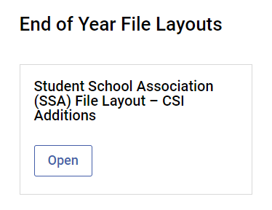
Reminder: Review Entry/Exit Codes and Dates
Review Entry and Exit Codes on pages 5-12 of the SAA File Layout.
Notes:
It is highly recommended that all data submissions contacts review the Entry/Exit module as a reminder of how to correctly code Entry and Exit types. This is the area in which we see the most end of year errors and inadvertently miscoding a student could lead the system to believe that the student has dropped out!
Be sure that you are reviewing Entry/Exit codes and training and noting, as the school year wraps up, students who may have Entry or Exit scenarios that need reviewing.

Slide 17
Next Steps

Slide 18
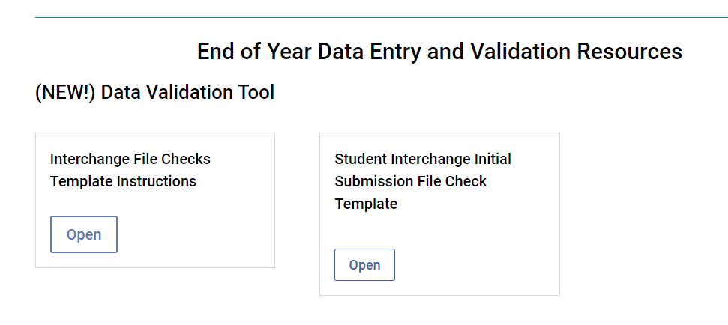
https://resources.csi.state.co.us/end-of-year/
Notes:
Now that you have an idea of what is new this year, please head over to the End of Year Collection webpage and to get started on the new validation tool. Information on the tool can be found under the Data Entry and Validation Resources Heading.

Slide 19
Thank you
Graphics from pixabay.com
Notes:
Thanks so much for making it all the way through this training and we hope you enjoy the new validation tool!

