Slide 1
Spring 2020 READ Act Data Collection

Slide 2
Data privacy and security
Purpose of the READ data collection
READ collection timeline
READ Cohort
2019-20 data elements
Common problems and questions
Q&A session

Slide 3
Data privacy and security

Slide 4
Data privacy and security
Submissions>READ Act>READ Act 2020

Slide 5
Purpose of the READ data collection
Required by statute
Fund distribution
Reporting, legislative updates, grants, etc.
ALL K-3 students included

Slide 6
New this year: READ Budget
READ Budget survey is gone.
Finance contacts at schools will be sent a READ Budget template that must be submitted by May 1.
Screenshare/ allowable uses

Slide 7
READ collection timeline
Now through May 17: Assess all K-3 students
Update Cohort file
May 18: Deadline for file submission
May 18-June 1: Correct Errors
Early August: READ funds distributed

Slide 8
READ 4-10th Cohort
Separate file- students who left 3rd grade with a READ plan and have not been indicated as exiting their plan in prior year(s).
Only ONE field to update
Do not copy paste into main READ Collection file

Slide 9
Update this field with a 0 or 1 ONLY

Slide 10
READ Cohort
When does a student exit the cohort?
Once a student has reached reading competency (determined locally) they are removed from their READ plan and will be coded as READ plan = 0 (No) which will remove them from the cohort group
Do not add students into the cohort.
ONLY the READ plan field is updated

Slide 11
2019-20 data elements
Only changes: aimsweb no longer approved; Full day K no longer acceptable use
Use most current excel template. Submitted files must be in excel or .csv format.
Screenshare: Template

Slide 12
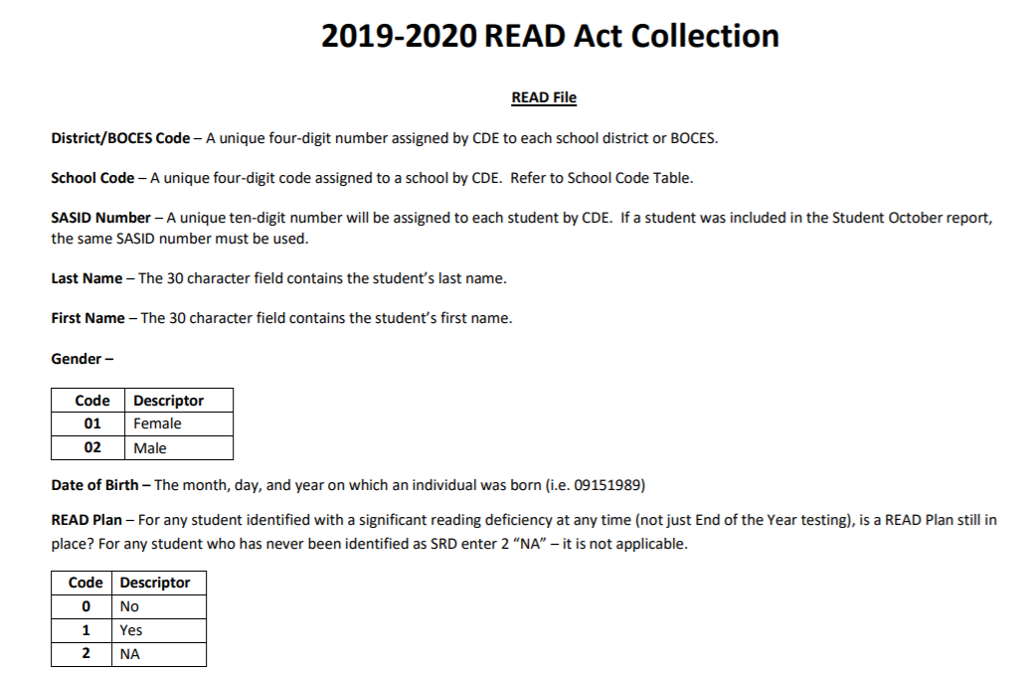
CSI= 8001

Slide 13
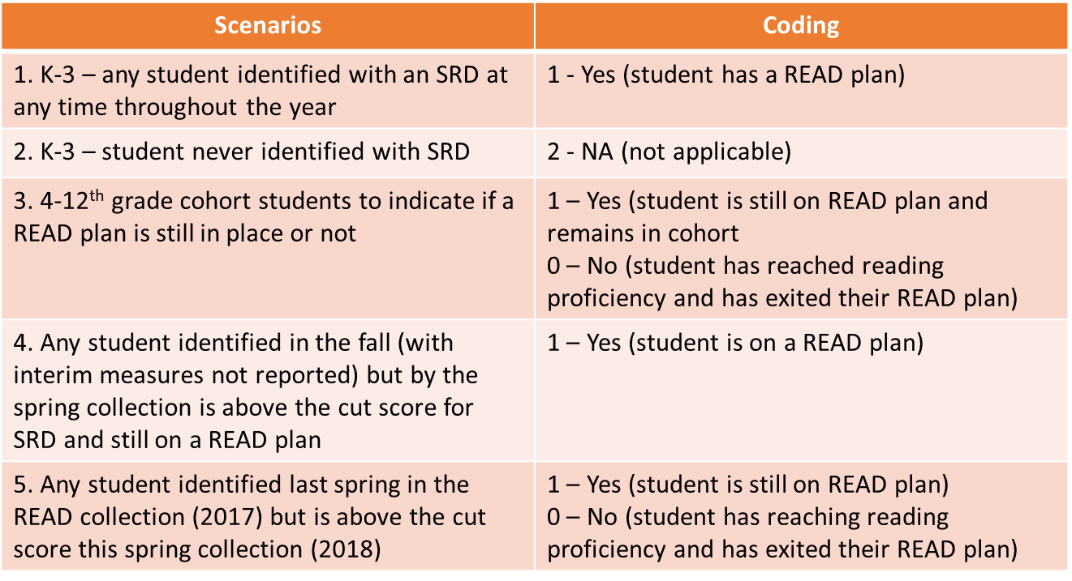
How to use the READ Plan field

Slide 14
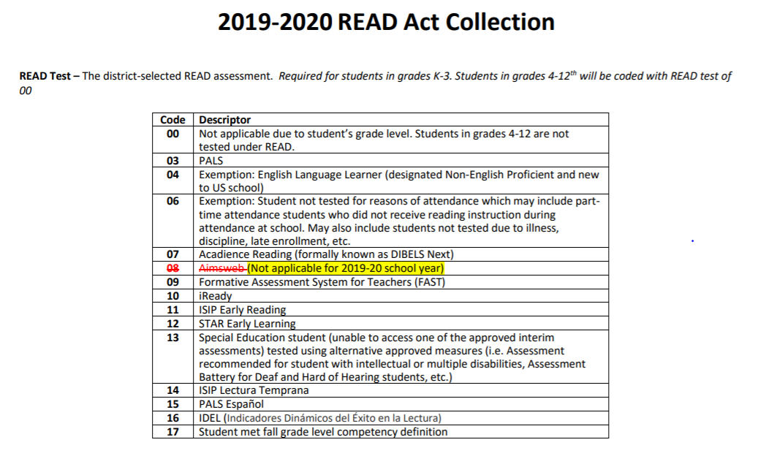

Slide 15
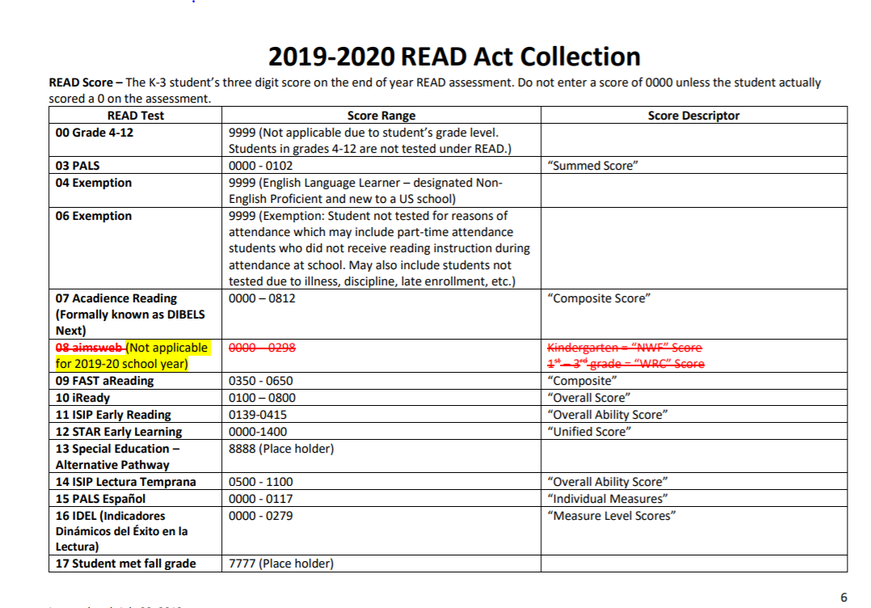

Slide 16
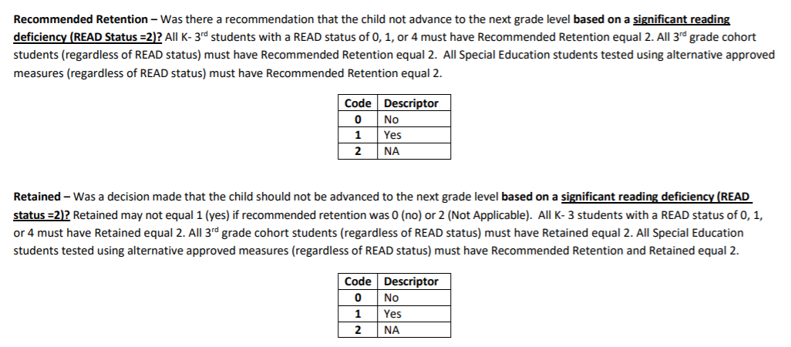

Slide 17
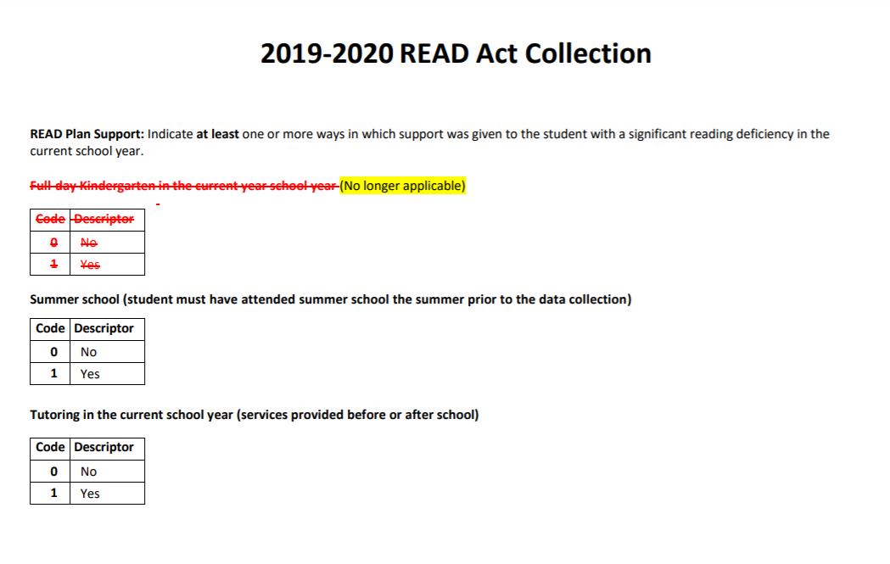

Slide 18
Common Problems & Questions
Losing Leading Zeros
Opening a file in excel and format is not already set to ‘text’
Files will not upload properly and will create errors

Slide 19
Common Problems & Questions
An English Language Learner in our school was tested because she is not NEP and she is beyond her first year in a US school. She received a score low enough on PALS to qualify as having a significant reading deficiency. We don’t believe the score accurately reflects SRD because we have a body of evidence that says she can read fluently in her first language.
READ Plan = 2 (NA because student was not identified with a SRD)
READ Status = 4
READ Test = 07
READ Score = 0170
READ Testing Date = 05202020
Recommended Retention = 2
Retained = 2
READ Plan Support = 0 for each

Slide 20
Common Problems & Questions
A student in my school was unable to be tested due to excessive absences, but the child was enrolled during the period for testing and has a READ Plan in place
READ Plan = 1
READ Status = 0
READ Test = 06
READ Score = 9999
READ Testing Date = 05202020
Recommended Retention = 2
Retained = 2
READ Plan Support = Indicate the supports the student received

Slide 21
Common Problems & Questions
An English Language Learner in our school wasn’t tested because he is Non-English Proficient (NEP) and in his first year in a US school.
READ Plan = 2
READ Status = 0
READ Test = 04
READ Score = 9999
READ Testing Date = 05202020
Recommended Retention = 2
Retained = 2
READ Plan Support = 0 for each

Slide 22
Common Problems & Questions
A 1st grade student in our school was placed on a READ plan earlier this year. The Spring DIBELS score is above the cut score so she is no longer identified as having a significant reading deficiency. However, the body of evidence doesn’t demonstrate she is at grade level yet. We will keep her on a READ plan.
READ Plan = 1
READ Status = 1
READ Test = 07
READ Score = 0812
READ Testing Date = 05202020
Recommended Retention = 2
Retained = 2
READ Plan Support = 0 for each

Slide 23
READ Resources
READ Collection resources can be found at:
https://resources.csi.state.co.us/read-data-collection/
http://www.cde.state.co.us/coloradoliteracy/readdatapipeline

Slide 24
Don’t forget!
DUE DATE: MAY 18
FileZilla: Submissions>READ Act>READ Act 2020

