Slide 1
Student Interchange (October Count and EOY)Training Initial Submission File Check Template Module

Slide 2
Purpose and Validation Resources

Slide 3
Purpose of Interchange File Checks Template
The purpose of the Interchange File Checks Template is for schools to review their initially extracted Student Demographics (SD) and Student School Association (SSA) Files prior to initial Submittal. The template will flag for potential errors that can be corrected prior to initially submitting files. The goal of this resource is to:
Identify errors and correct prior to submittal Fewer errors received upon initial submittal Fewer submissions until error clearance Collection errors cleared earlier in the process
Instructions for using the Initial Submissions File Checks Template

Slide 4
Initial Submission Data Validation Resources
CSI has two main resources should be used in conjunction to clear up data entry issues prior to initial submittal of the October Count and End of Year Collections. These include:
As Data Entry is being completed, the Validation Strategies Checklist should be used first to review and update common errors or missing information. Once complete and files extracted, the Interchange File Checks should be used to catch any other data entry errors or missing information.
This File Check resource is not designed or capable to catch every potential error, but more common data entry issues.
Both webpages contain other resources that will assist in this process as well (File Layouts, Training Modules, EL Coding Resources etc.).
SD/SSA Data Validation Strategies Checklist
Interchange File Checks Template

Slide 5
Interchange File Check Template Instructions

Slide 6
File Check Template Instruction Overview
Follow these steps to complete a review on initial Student Interchange data files: Extract both the Student Demographic and Student School Association files directly from your schools SIS and save as a CSV Navigate to the CSI website and open the File Checks Template Open both the SD and SSA files and paste into the Raw Data tabs in the template Review the “SD Error Checks” and “SSA Error Checks” tabs in the template paying attention to any highlighted fields that indicate errors Make updates directly in the schools SIS and extract new files. These can be pasted into the template again to double check nothing has been missed Once all are corrected, the newly extracted files can be submitted to CSI for processing Instructions can also be found: https://resources.csi.state.co.us/interchange-file-checks-template-instructions/

Slide 7
Steps to Utilize the File Check Template

Slide 8
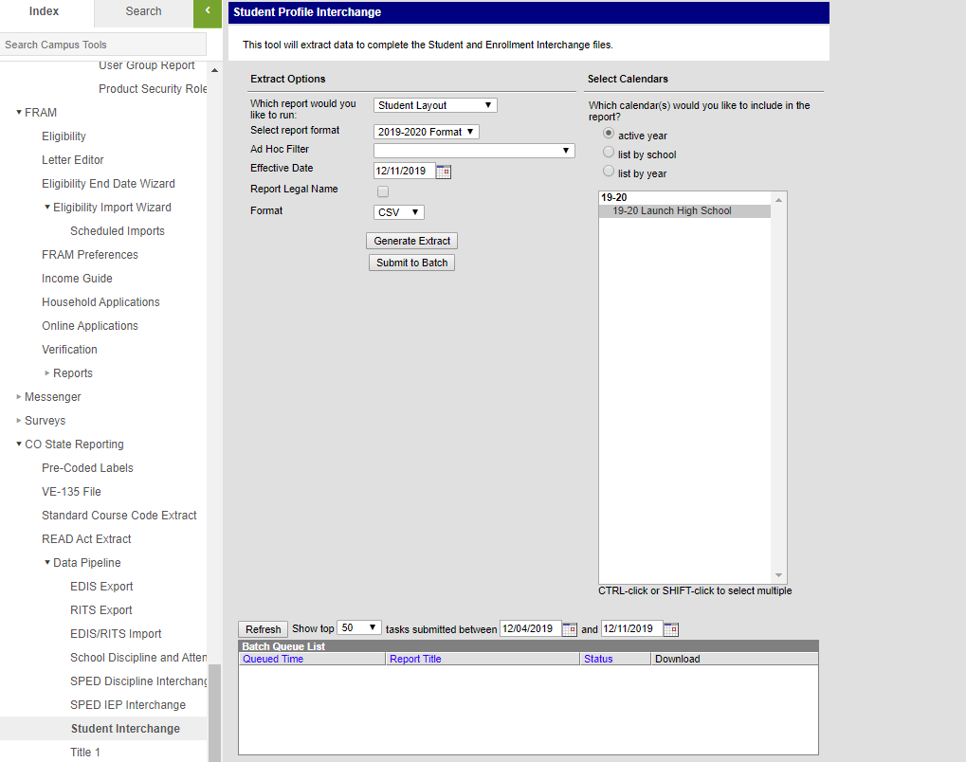
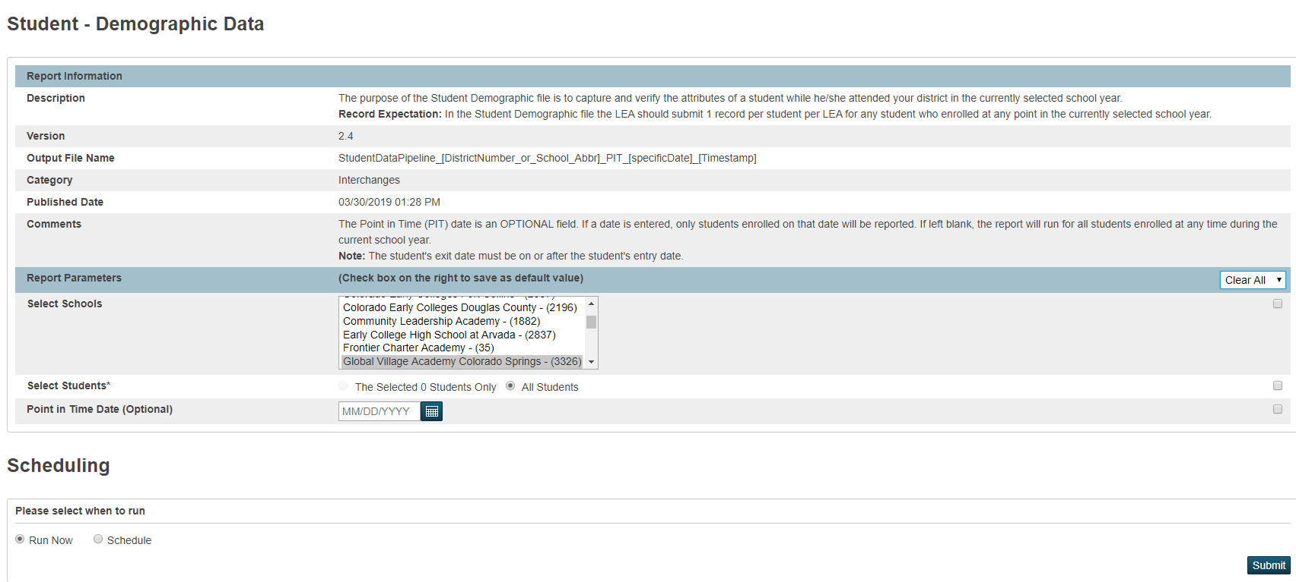
Step 1: Extract Files from Schools SIS
Navigate to PowerSchool, Infinite Campus or other school SIS used and extract both the Student Demographics (SD) and Student School Association (SSA) files directly from the applicable Colorado State Reporting section. Files must be saved prior to opening as usual procedure. The correct naming structure should be used in case files will be submitted (ex. 3326_CILA_SD_02012020) Files must be saved as a .CSV for file check template to work properly.

Slide 9
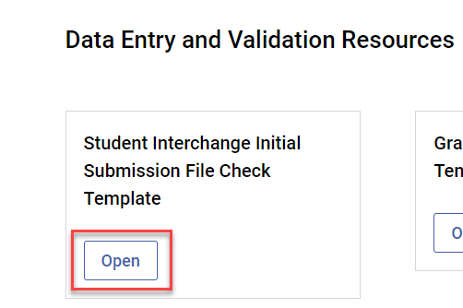
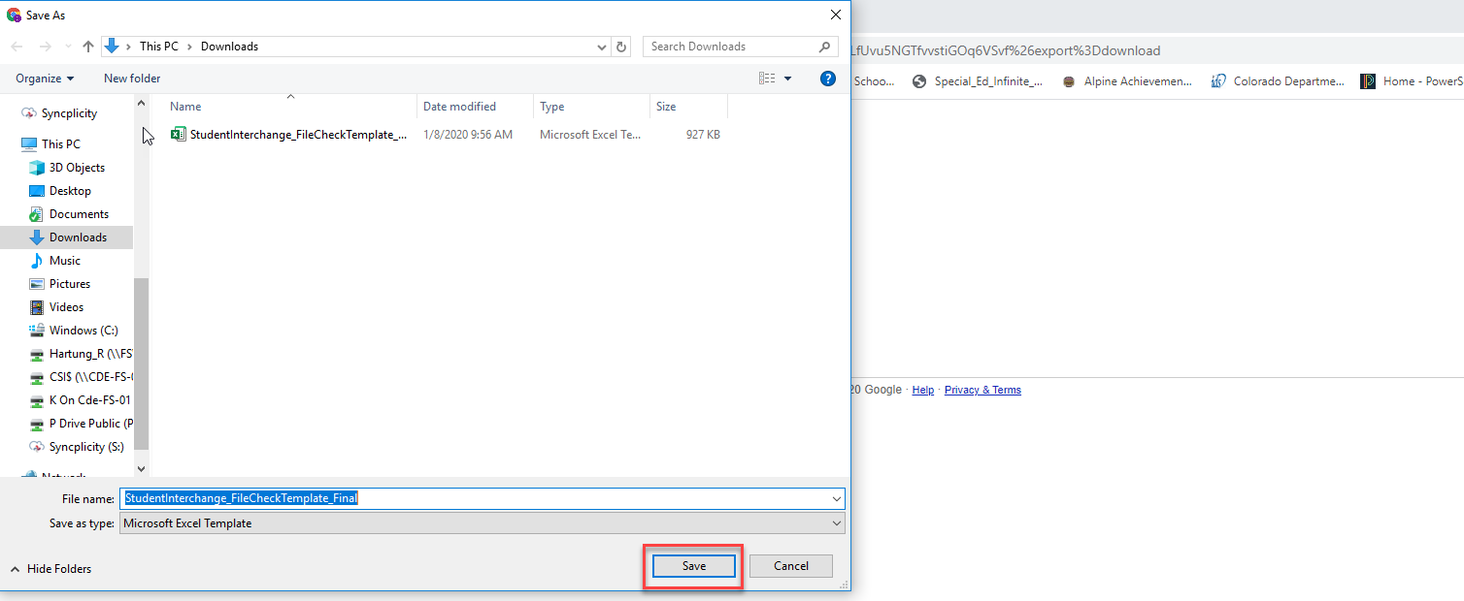
Step 2: Access File Check Template
The File Check Template is currently located on the CSI End of Year homepage under the Data Entry and Validation Resources header. It will also be included on future October Count updates. The Excel Template file has also been emailed to schools prior to the initial submittal due date. Once Open has been clicked on, click the Download the file icon in Google Sheets and save to your computer as an Excel file, which can be utilized as often as needed. The file contains 4 worksheets with 2 being for pasting raw data and the others displaying potential errors. https://resources.csi.state.co.us/interchange-file-checks-template-instructions/

Slide 10
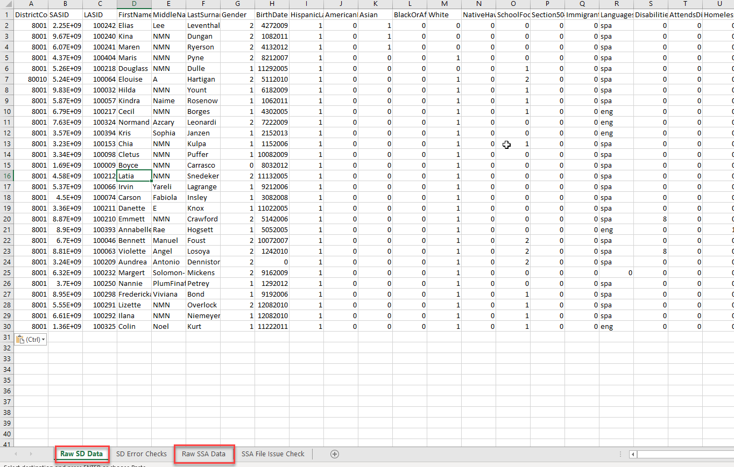
Step 3: Open and Paste Data Files
Once the Template file has been downloaded and saved to your computer. Open the file to begin the check process. Navigate to the location of the saved SD and SSA files and open them as well. The files will lose their leading zeros, which are not needed during checks. Copy the entirety of the raw SD file and paste directly into the Raw SD Data tab located in the template. Complete the same process for the SSA file pasting into the Raw SSA Data tab.

Slide 11
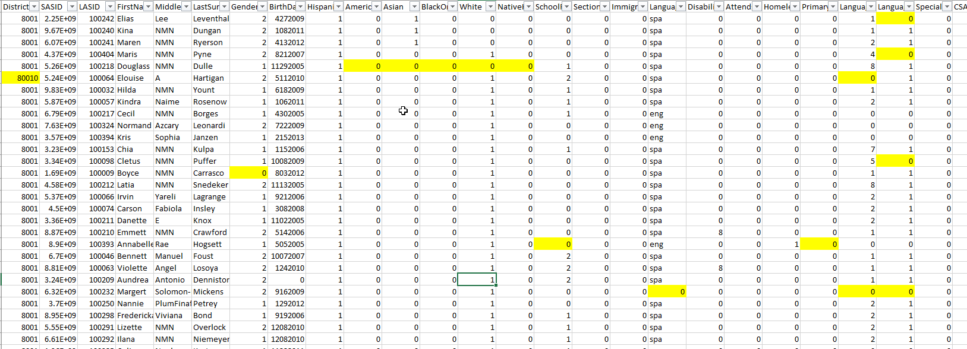
Step 4: Review Error Check Tabs
After pasting, navigate to both the SD and SSA File Checks tabs located in the template. Any field that may present an issue or potential error will be highlighted directing the user what needs to be updated. This tool is not designed to catch every error or issue, but many of the common data entry errors a student may have within their SIS.
SD File Checks Tab
SSA File Checks Tab

Slide 12
Step 4: Review Error Check Tabs Cont.
Below is a listing of potential SD errors or issues that you may encounter upon pasting your raw data files: *Message shows how flag looks on check template but does not reflect the leading zero intended in the field.
Highlighted SD Field | Issue Flagged
School District/BOCES Code | Students not coded with an 8001 for this field
Student’s State ID (SASID) | Missing or zero-filled SASIDs
First, Middle, and Last Name | Missing or zero-filled Names
Student’s Gender | Gender not coded either a 1 or 2 for Female and Male*
Student’s Date of Birth | Blank or zero-filled Dates of Birth
Student’s Ethnicity | Ethnicity coded as something other than 0 or 1, including negatives
5 Race Detail Fields | All 5 individual Race fields coded as 0
Free/Reduced Lunch Eligible | Students coded as Homeless or Immigrant and have zero-filled FRL*
Homeless | Student having a Primary Nighttime Residence of 1-4 and a zero-filled Homeless status
Primary Nighttime Residence | Students flagged as 3 or 4 in the Homeless field, but a Primary Nighttime Residence of 00
Language Background | Zero-filled Language Background
Language Proficiency | Students Language Background is something other than ENG, but the Language Proficiency is zero-filled.
Language Instruction Program | Students Language Background is something other than ENG, but the Language Instruction Program is zero-filled.

Slide 13
Step 4: Review Error Check Tabs Cont.
Below is a listing of potential SSA errors or issues that you may encounter upon pasting your raw data files:
Highlighted SSA Field | Issue Flagged
School District/BOCES Code | Students not coded with an 8001 for this field
Student’s State ID (SASID) | Missing or zero-filled SASIDs
First, Middle, and Last Name | Missing or zero-filled Names
Student’s Gender | Gender not coded either a 1 or 2 for Female and Male *
Student’s Date of Birth | Blank or zero-filled Dates of Birth
Entry Date | Missing or zero-filled
Entry Type | Missing or zero-filled
Grade Level | Missing or zero-filled
Exit Withdraw Date | Exit Date missing, but Exit Type is a non-zero value
Exit Withdraw Type | Exit Type missing with a valid Exit Date
Pupil’s Attendance Information | A PAI Code that is something other than 4*
County of Parent’s Residence | Anything other than a zero-filled answer
District of Parent’s Residence | If field is zero-filled or coded with 8001
Country of Parent’s Residence | Anything other than a zero-filled answer
State of Parent’s Residence | Anything other than a zero-filled answer
Public School Funding Status | If field is zero-filled or coded as an 82 – Part Time for grades other than Kindergarten
Total Days Attended | Zero filled attendance information
Total Days Excused | Zero filled attendance information
Total Days Unexcused | Zero filled attendance information
Total Days Possible | Zero filled attendance information
*Message shows how flag looks on check template but does not reflect the leading zero intended in the field.

Slide 14
Error Check Limitations
Not designed to catch every error you may encounter Potential flags of valid data in unusual scenarios
Errors Not Flagged | Potential Flags of Accurate Data
Issues with SASIDs not matching what is in RITS | Part-Time Funding for students not in Kindergarten may be correct
Age to Grade inconsistencies | Students coded as FEP Exited Year 1 or 2 (8 or 9) may not need a Language Instruction Program
Duplicate SASIDs across CSI schools | District of Residence field may potentially be zero filled in very rare circumstances where State of residence field is included
Overlapping enrollments across CSI schools | The Days Attended and Total Days Possible fields will flag if resource is utilized for October Count, which does not report attendance errors
Incorrect School Codes | The Pupils Attendance Information may not be 04 in extremely rare circumstances
English Learner logical progression issues | All Attendance fields will flag if zero filled, including excused and unexcused. This may be accurate for students with no absences.

Slide 15
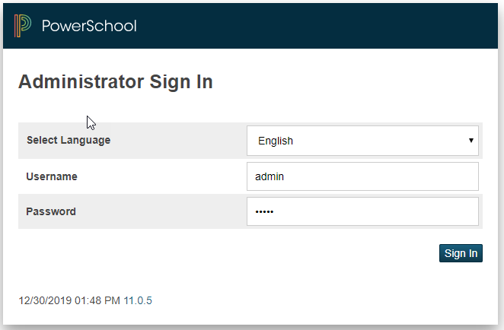
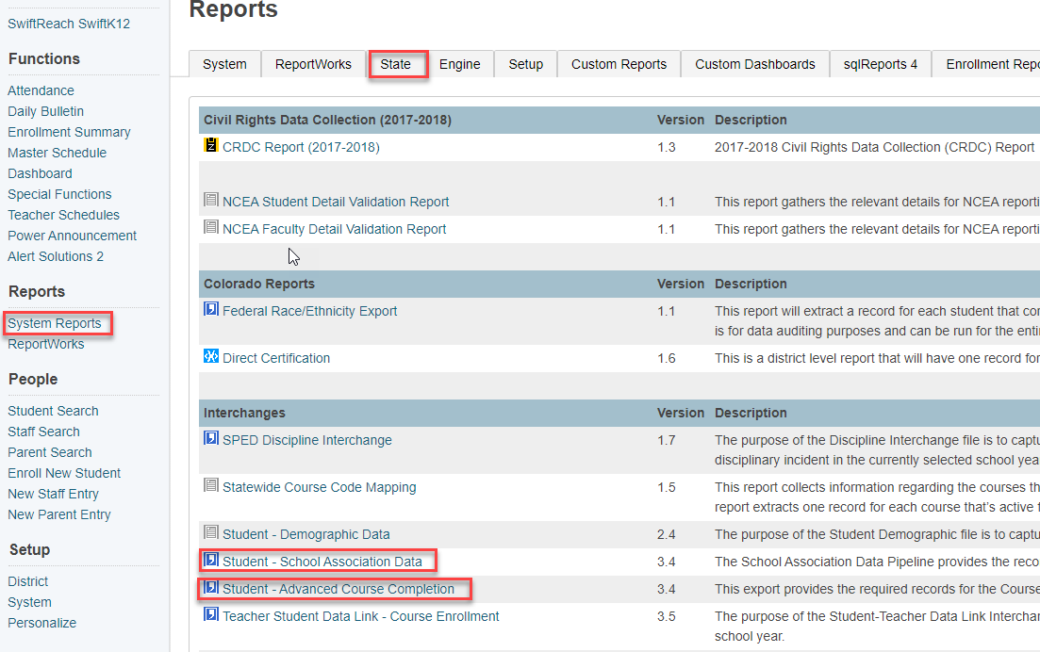
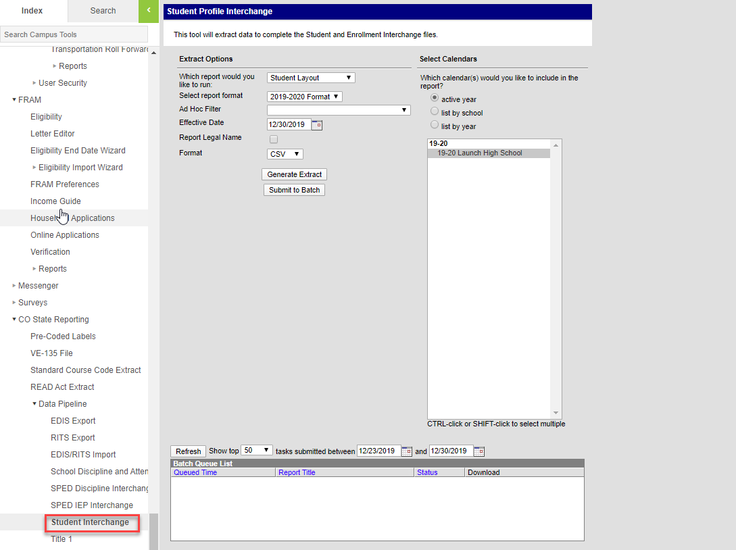
Step 5: SIS Updates
Once issues are reviewed and identified, navigate back to your SIS and make any necessary updates and corrections to the students record. As all highlighted issues have been updated, new files can be extracted from your SIS. Repeat process if necessary, to ensure that all issues have been resolved

Slide 16
Step 6: Submit Initial Files to CSI
After newly extracted files have been reviewed and correctly named, submit your initial files to FileZilla and email the Submissions Inbox (Submissions_CSI@csi.state.co.us) CSI will process the files and provide you initial error reports. The goal of this process will be less errors upon initial submittal leading to less submittals to error clearance saving both the school and CSI time in the process!

Slide 17
Thank you for Reviewing this Module
Contact the Submissions Inbox with Questions:
Submissions_CSI@csi.state.co.us

