Slide 1
Discipline Webinar Anastasia Hawkins, Director of Legal and Policy Initiatives Marisa Bayless, Legal and Policy Associate

Slide 2
The following is provided for informational purposes only and is not to be construed as legal advice or a formal legal opinion on the behalf of the author or CSI. Use of this information does not create an attorney-client relationship, nor is the creation of such relationship intended by the provision of this information. This information does not constitute a formal administrative opinion on behalf of CSI. CSI recommends that each school contact its attorney to obtain legal advice with respect to any particular issue.

Slide 3
Overview
This presentation is intended to review key aspects of the CSI Sample Discipline Policy. Reviewing the presentation with the policy in hand will be the most beneficial.
Please see the sample policy here.
This sample policy can be used in its entirety or specific portions may be utilized to enhance existing policies. However, all parts in red are taken directly from statute and if used, may not be altered.
You should have your counsel review this policy if you decide to make any changes and before any policy is distributed.

Slide 4
Overview
If you hold the waiver from C.R.S. 22-33-105(7)(b), the process for disciplinary appeals, CSI must review and approve the School’s disciplinary process.
The Legal and Policy Team is happy to help any schools who do not hold the waiver in reviewing their discipline policies and procedures.
If you have any questions regarding the waiver, please contact the CSI Legal and Policy Team.
Contact information is included at the end of this presentation
Notes:
As will be discussed more in-depth in a later slide, if you hold this waiver, instead of disciplinary appeals going to CSI’s Governing Board, the appeals would go to the School’s governing board.

Slide 5
Why this policy?
Schools’ discipline policies and procedures are continually being reviewed and monitored by districts, authorizers, and outside parties in response to a growing understanding of how discipline practices affect students and their future lives and careers.
This sample policy is intended to help schools outline their discipline process for parents and students, as well as give a guideline for school administrators and teachers.
CSI receives complaints from the public and parents of students. These complaints typically revolve around discipline. By creating a discipline policy, CSI will be able to better inform parents of the process.
Notes:
The ACLU and other organizations have also recently completed reviews of charter school discipline policies in other states such as California and Arizona in an attempt to show how they believe school discipline policies can create the school-to-prison pipeline as well as the equity in access effects these policies can have on students.

Slide 6
CSI’s Sample Discipline Policy
Notes:
As you review these slides, have the sample discipline policy in front of you, as this presentation will be discussing important aspects of the policy.

Slide 7
Discipline Philosophy
Discipline policies should include a statement of the school’s discipline philosophy and how that coincides with the school’s mission and vision and other focuses.
Notes:
If you are a school that practices restorative justice or have a focus on ensuring equity in your school, or any other distinct mission, then you can add a statement about this at the beginning of your policy and how your discipline practices furthers that goal or mission. This is your chance to tailor your policy to your school specific mission, vision and goals.

Slide 8
Students with Disabilities
Discipline for students with disabilities must be in accordance with a student’s IEP or 504 and include all the procedural safeguards for students with disabilities mandated by state and federal law.
Notes:
Please contact CSI’s Student Services department if you have questions regarding discipline for students with disabilities.
Please note: There are different timelines and different triggers for students on IEP’s and 504’s than for a traditional student.

Slide 9
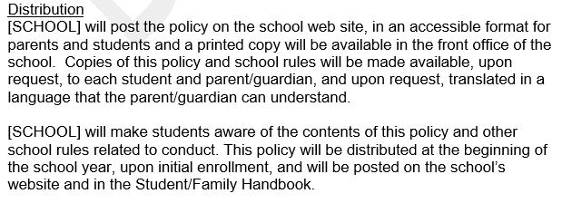
Notes:
Ensure the policy is up to date on all places where you can access it
The policy should be available in your student handbook – whether in the document or as an attachment/addendum

Slide 10
Minor Disciplinary Offenses
Notes:
Certain minor disciplinary offenses may not need to go through this process, as they would not be statutory reasons to suspend or expel a student. Explain the process so that students and parents are aware of the potential consequences (detention, revoking extra-curricular privileges).
Because this will become the discipline policy that your school utilizes, it is imperative that you also include a description or list of those items that may fall into your minor offenses category. Otherwise, parents and students may believe the only offenses students will be disciplined for are those that rise to the level of suspension and/or expulsion as are laid out in this sample policy.

Slide 11
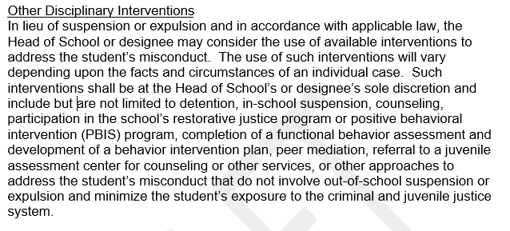
Notes:
You can tailor this to your school’s specific disciplinary interventions schedule/process

Slide 12
Other Disciplinary Measures
The goal is to have the child in the classroom so that educational opportunities are not missed.
Can tailor this section specifically to what the school offers in the use of other interventions and what this looks like in practice.
Use other schools as resources. Please reach out to CSI if you would like to know more about what other CSI schools use and we can help connect you.

Slide 13
Procedure for Removal of Disruptive Students from Classroom
Statutory based
A student may be deemed a “habitually disruptive” student, if the student has caused a disruption on school grounds, in a school vehicle, or at a school activity or sanctioned event three or more times during the school year.
Notification
Each time a student’s disruption is considered “habitually disruptive”, the student and legal guardian must be notified.
Notes:
Think about your method of notification, the method the school uses to track these disruptions.
Teachers should be aware of what needs to be noted as a “habitually disruptive” incident and what is not and what their responsibility is in tracking these incidents.

Slide 14
Procedure for Removal of Disruptive Students from Classroom
Behavior Plan
After the first removal, a behavior plan may be developed.
After the second removal, a behavior plan must be developed.
Note the difference between a removal for disruption and the use of seclusion:
Definition of Seclusion: "Seclusion" means the placement of a student alone in a room from which egress is involuntarily prevented. "Seclusion" does not mean:
Placement of a student in residential services in the student's room for the night; or
“Time-out”, which is the removal of a student from potentially rewarding people or situations. A time-out is not used primarily to confine the student, but to limit accessibility to reinforcement. In time-out, the student is not physically prevented from leaving the designated time-out area and is effectively monitored by staff.
Notes:
The school should have a process in place where a student who has been removed from the classroom for being habitually disruptive goes and what that child does in that time.

Slide 15
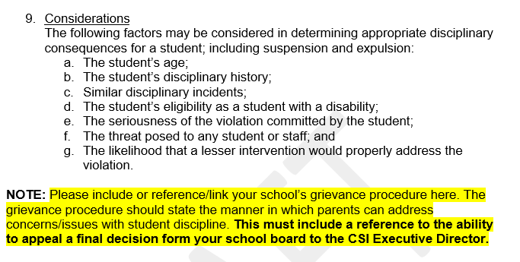
Notes:
Also consider new PK-2 Discipline changes that can be found here: https://resources.csi.state.co.us/pk-2-discipline-advisory-bulletin/
The considerations listed under item 9 should be discussed with your staff prior to the beginning of the school year. This will help ensure that your disciplinary practices have consistency across the school.
Example: First grade student suspended for bringing a toy to school.
Consider the student’s age, the seriousness of the violation and the likelihood that a lesser intervention would properly address the situation.

Slide 16
Grounds for Suspension and Expulsion
Please see the notes for the full list of grounds for suspension and expulsion that are taken directly from statute and may not be altered.
Certain categories need to be clearly defined, to ensure discipline is determined in an equitable manner . Administrators and teachers should all be knowledgeable and on the same page as to the definition of these offenses.
“Continued willful disobedience or open and persistent defiance of proper authority”
“Repeated interference with a school’s ability to provide education opportunities to other students”
Notes:
Grounds for suspension and expulsion – C.R.S. 22-33-106
Continued willful disobedience or open and persistent defiance of proper authority
Willful destruction or defacing of school property
Behavior on or off school property that is detrimental to the welfare or safety of other pupils or of school personnel, including behavior that creates a threat of physical harm to the child or to other children
Note: if a child who creates the threat is a child with a disability pursuant to section 22-20-103(5), the child may not be expelled if the actions creating the threat are a manifestation of the child’s disability.
Declaration as a habitually disruptive student
“Habitually disruptive student” means a child who has caused a material and substantial disruption on school grounds, in a school vehicle, or at a school activity or sanctioned three or more times during the course of a school year.
Committing one of the following offenses on school grounds, in a school vehicle, or at a school sanctioned event:
Possession of a dangerous weapon without the authorization of the school
The use, possession, or sale of a drug or controlled substance as defined in section 18-18-102(5); or
The commission of an act that, if committed by an adult, would be robbery pursuant to section 18-4-3, other than the commission of an act that would be third degree assault under section 18-3-204, if committed by an adult.
Repeated interference with a school’s ability to provide education opportunities to other students
Carrying, using, actively displaying, or threatening with the use of a firearm facsimile that could reasonably be mistaken for an actual firearm in a school building or in or on school property
Pursuant to section 22-12-105(3), making a false accusation of criminal activity against an employee of an educational entity to law enforcement authorities or school officials or personnel
Pursuant to 20 U.S.C. sec. 7961, a student who is determined to have brought a firearm to school, or to have possessed a firearm at a school, shall be expelled for a period of not less than one year; except that the superintendent of the student’s Head of School may modify this requirement for a student on a case-by-case basis if such modification is in writing.

Slide 17
Procedure for Suspension of 10 Days or Less
Discipline Determination Meeting
Informal, should happen immediately
Place to gather evidence, let the student explain his or her position
This is not an extensive meeting and should not last a significant period of time
Notice
Head of school shall immediately notify the student and parent of the decision to suspend. May be oral or in writing, but should always include a follow-up written notice if the decision is stated orally.
Contents of Notice
Statement of what the student is accused of doing, basis for the accusation, statement of what school/rules policies the student is accused of violating, period of suspension, and time and place for the parent/guardian to meet with the school to review the suspension.

Slide 18
Procedure for Suspension of 10 Days or Less
Removal from school grounds
A suspended student shall be required to leave the school building and the school grounds immediately following a determination by the parent/guardian and the Head of School or designee of the best way to transfer custody of the student.
Consider: when a parent chooses to not pick up a student
Readmittance
School should make every reasonable effort to meet with the parent/guardian of the student during the suspension period. However, if the Head of School or designee cannot contact the parent/guardian or if the parent/guardian fails to appear for scheduled meetings, the suspending authority may admit the student. The Head of School or designee shall not extend a period of suspension because of the failure of the Head of School or designee to meet with the parent/guardian during the suspension.
Notes:
Schools should consider situations where a parent chooses not to pick up a student after a decision to suspend and what process a school will follow if this event occurs.
Considerations can include:
Place the student in in-school suspension until the parent comes to pick the student up. [inform the parent this is what will happen until they are able to pick up the student]
Consider following this same process if parent refuses to keep student home and drops them off at school on days that the student should be suspended.
As a LAST RESORT you may: Inform the parent that if they refuse to pick up the student from school, you will have to reach out to school resource officer/law enforcement as student would be considered abandoned at that point by parent.

Slide 19
Procedure for Suspension of 10 Days or Less
Make-up Work
School should have a policy in place for suspended students to have an opportunity make up school work during the suspension period.
The goal is to reintegrate the student back into the classroom and prevent the student from dropping out.
Notes:
Schools should have a procedure in place for make-up work during the suspended period for the student and be able to explain to the parent and student what is required for the student to receive credit.
This policy should be communicated to students and parents before the suspension is imposed.

Slide 20
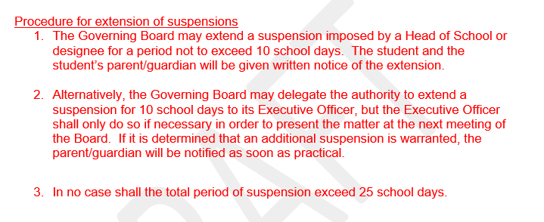
Notes:
Note: Ensure consistency with your school’s governing board policies.

Slide 21
Notes:
This procedure statutorily covers denial of admissions as well but we will only be talking about this in the context of expulsion.
Expulsion is the last resort:
Ramifications for expulsion will have lasting effects on a student – other schools can then deny that student admittance.
This should not be used frequently.
Remember that this is also reported to the State in data collections
Legal counsel should always be consulted when deciding to move forward with an expulsion.

Slide 22
Procedure for Expulsion
Notice
Prior to the date of the expulsion, Head of School will provide written notice of the action as soon as possible.
Contents of notice
A statement of the reasons alleged for the contemplated denial of admission or expulsion;
A statement that a hearing on the question of expulsion or denial of admission will be held;
A statement of the date, time, and place of the hearing;
A statement that the student may be present at the hearing and hear all information against him or her, that the student will have an opportunity to present defending or clarifying information, and that the student may be accompanied and represented by a parent/guardian and an attorney;
A statement that failure to participate in such hearing constitutes a waiver of further rights in the manner.
Notes:
All notices should be reviewed by legal counsel

Slide 23
Procedure for Expulsion
Conduct of Hearing
Should be conducted by a hearing officer.
A sufficient record should be kept for any future appeals.
The hearing officer will forward its findings to the Executive Officer designated by the Governing Board who will make the final decision.
The Executive Officer will render a decision no later than five school days.
Notes:
The hearing officer should be a neutral third party. If it is a staff member, it should be an administrator with knowledge of the discipline policy, but who was not directly involved in the proposed expulsion.
The hearing should be structured and contain opportunities for all parties involved to speak. Please reach out to CSI if you need help with this process.

Slide 24
Appeal
Student or guardian may appeal in writing within 10 days of the Executive Officer’s decision.
The Governing Board will set the matter for hearing at its next regular meeting
During this time, the 25 school day suspension rule is still in place and the Governing Board may have to call a special meeting to ensure this timeline is met.
NOTE: If you do not have the waiver for 22-33-105(7)(b), then expulsions appeals are heard before the CSI Governing Board, not the school’s governing board. This waiver only waives the school out of this procedure for appeals to go to the CSI Governing Board. The school is still bound by the other provisions in 22-33-105 and 22-33-106.
Notes:
Hearing officer should be a neutral third party. If a staff member, it should be an administrator with knowledge of the discipline policy, but who was not involved in the proposed expulsion or denial of admission.
If you DO NOT have the waiver for 22-33-105(7)(b) and you DO NOT want expulsion appeals to be heard by the CSI Board, please reach out to Marisa Bayless so we can work on getting the waiver for your school.

Slide 25
Appeal
Appeals should be heard in Executive Session.
Upon conclusion of review, the Governing Board may vote to affirm, reverse, or modify the Executive Officer’s decision.
Any written public order should be redacted to ensure compliance with FERPA.

Slide 26
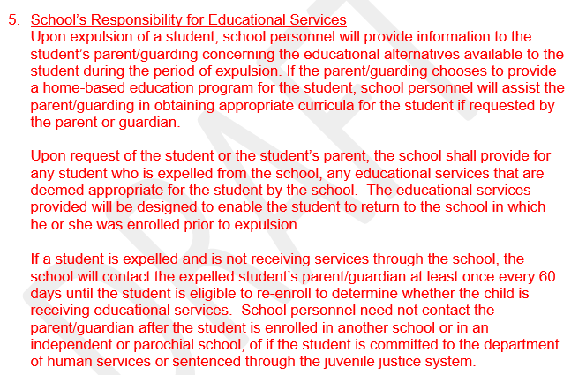
Notes:
This is a statutory obligation to provide services upon the request of the parent.

Slide 27
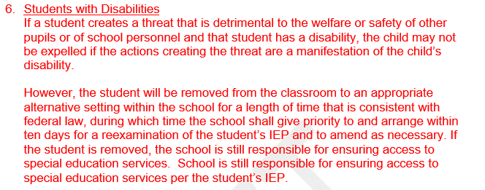

Slide 28
Readmittance after Expulsion
Your readmittance procedure for expelled students should include whether or not the child must apply and reenroll in the school or if the school holds that spot for them after the expulsion period has ended
This is not a settled legal question. You should ask your legal counsel on how your school should proceed.

Slide 29
Discipline Related to Title IX
The Legal & Policy team will be providing a Title IX webinar and training this year which will go in depth about all things Title IX in a K-12 school
If you are in the process of completing a Title IX investigation and are considering discipline related to the conduct at issue, ensure that your legal counsel has been consulted.

Slide 30
Keep an eye out for an upcoming webinar by the CSI Data & Submissions Team. This webinar will discuss how to track and input discipline related information into your SIS. This webinar will take place in mid-August.

Slide 31
Thanks!
Any questions?
Anastasia Hawkins (303-866-6960), anastasiahawkins@csi.state.co.us.
Marisa Bayless (303-866-6714), marisabayless@csi.state.co.us.

