Slide 1
2018-2019 ACCESS administration

Slide 2
DISCLAIMER
***This is a high-level training for SACs. This DOES NOT replace reviewing the School Coordinator Manual and the Test Administrator Manual.

Slide 3
Agenda
Overview of ACCESS
Paper
Online
Preparing for testing
Administration
WIDA AMS
Accommodations
Materials
Training requirements
Resources
Next Steps

Slide 4
ACCESS for ELLs 2.0 Suite of Assessments
The following assessments are used to satisfy state and federal requirements for the annual assessment of the English language proficiency of English language learners (ELLs):
ACCESS for ELLs 2.0, an online and paper-based assessment for Grades 1–12
Kindergarten ACCESS for ELLs, a paper-based assessment for Kindergarten
Alternate ACCESS for ELLs, a paper-based assessment for ELLs in Grades 1–12 who have significant cognitive disabilities

Slide 5
Who takes ACCESS?
All NEP and LEP students enrolled at your school (K-12).
Families may not opt out of ACCESS testing (federally required test- state opt out law does not apply)
Students who are present during the window must be tested (even if they missed your school-specific test date).
Notes:
This includes students who have opted out of services

Slide 6
When is ACCESS?
January 14- February 15, 2019
Cut off to test late-enrolling students is February XXX

Slide 7
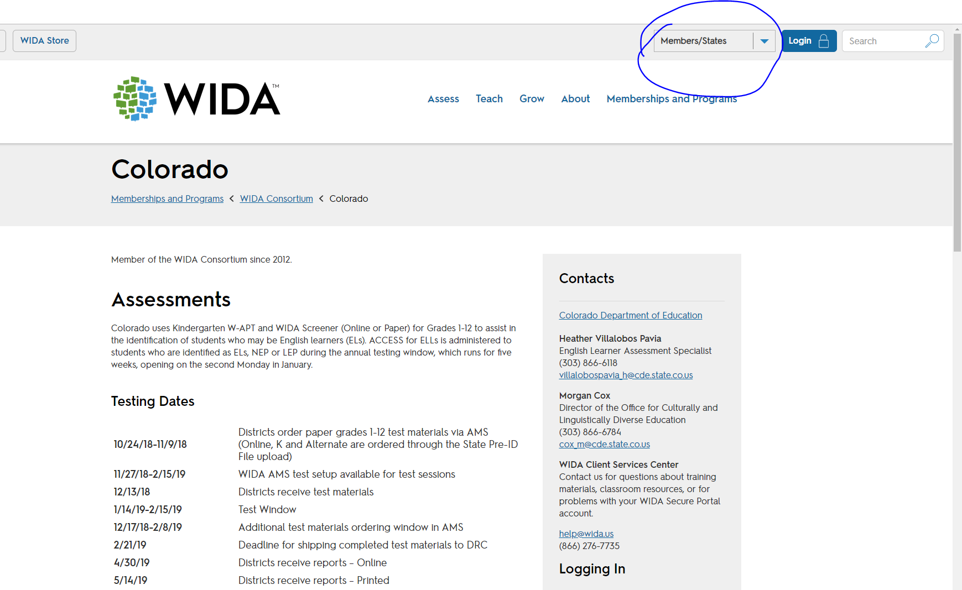
State-Specific Directions: Coming Soon…

Slide 8
Notes:
https://portal.wida.us/ACCESSTraining/Online/index.aspx

Slide 9
ACCESS for ELLs 2.0 Domains
Notes:
Do your teachers know this? Your students?

Slide 10
Preparing for testing: Scheduling
Consider:
Who are your TAs?
When will they be trained?
Who will have access to materials (should be 1-2 people)?
Who will distribute materials?
How will testing impact specials/field trips, etc?
What locations will you use for group testing vs. small group/ individual testing?
Who is your tech person? How will you communicate with them?

Slide 11
Paper Scheduling
Test order (Recommended):
Session 1: Listening/Reading
Session 2: Writing
Session 3: Speaking (Individual)
Limit group size to 22 students (recommended)
May NOT combine grade clusters/tiers in testing sessions.

Slide 12
Preparing for testing: Communication
Once you have built your schedule, how will you communicate with families?
Make-up testing is the worst- how can you maximize attendance?
Think about noise levels during testing- especially during speaking testing. Don’t schedule a drumming demo on the same days as testing.

Slide 13
Preparing for testing: Set-up
Paper: Number two pencils, CD player and speakers, desks set up so that students can’t see other test booklets
Online: Computers, headphones/headsets (for speaking and listening)
Decide: What will you do if students finish early? Will students be allowed to have water bottles?
Create a standardized, secure testing environment

Slide 14
Kindergarten ACCESS for ELLs
Individually administered
Completely adaptive
Includes manipulatives
All components are scored by the Test Administrator (TA) during test administration
Takes around 45 minutes
Anyone administering/scoring Kinder MUST take online training and quiz annually!
Notes:
The Kindergarten test form is individually administered and adaptive. Reading and Writing items allow students to demonstrate pre-literacy skills that many Kindergarteners are still in the process of acquiring. All components are scored by the Test Administrator (TA) during test administration.
There is a separate presentation which explains in much more detail how to administer and score the Kindergarten assessment- see WIDA website

Slide 15
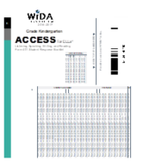
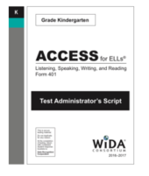
Kinder: Testing Materials
Student Story Booklet
Student Response Booklet
Test Administrator Script
Student Activity Board
Cards and Card Pouch Booklet

Slide 16
Kinder: Test Structure
See SECTION 4 of TAM
Narrative Section (Parts A-C) Part A: Listening & Speaking Part B: Writing Part C: Reading
Expository Section (Parts D-F) Part D: Listening and Speaking Part E: Writing Part F: Reading

Slide 17
Kinder: Test Administrators
Notes:
Training is incredibly important, as the tests must be scored in real time. Assign your most competent teachers to give and score this test.

Slide 18
ACCESS for ELLs 2.0 Paper
Grade Clusters
Tiers
Group administered Listening, Reading and Writing; individually administered Speaking
Media-delivered Listening and Speaking
Listening, Reading and Writing are scored by DRC
Speaking responses are locally scored
*Note: Kindergarten will remain an interactive, paper-based test.
Notes:
ACCESS for ELLs 2.0 Paper includes six grade-level clusters. In order to better measure younger students’ language development, ACCESS for ELLs 2.0 Paper includes a separate test form for Grade 1. There is also a separate Grade 2 form and a Grade 3 form. Grades 4 and 5, Grades 6 through 8, and 9 through 12 have grade cluster test forms. Kindergarten will remain an interactive, paper-based test for the foreseeable future. Note that when you receive the materials, you will notice that the Speaking test booklets are divided into five grade clusters (Grade 1, 2-3, 4-5, 6-8, 9-12). Use the appropriate form for the grade level the student is in.
Before administering the paper test, educators must select the appropriate Tier to give each student: A or B/C. More information about Tier Placement is on the next slide.
The Listening, Reading and Writing sections can be group-administered, but the Speaking section is always individually administered and scored by the Test Administrator.
On ACCESS 2.0 Paper, both the Listening and Speaking tests are media-delivered. What that means is that for Listening, the Test Administrator plays the pre-recorded passages with a CD and students respond in a test booklet. For Speaking, the Test Administrator plays the pre-recorded questions with a CD and scores students’ responses. Although the Speaking prompts are media-delivered, a trained Test Administrator needs to administer the Speaking test to students individually.
In the event a student requires the Listening and Speaking tests to be read by a human reader, as indicated in their IEP or 504 plan, this is allowable. In order to deliver this accommodation, a Human Reader Accommodation Script is required. The Human Reader Accommodation Script must be ordered by the District Test Coordinator from DRC on a case-by-case basis through the WIDA-Assessment Management System.
There are training modules in the WIDA Secure portal to prepare educators to administer all four test domains and rate students’ speaking responses locally. The Listening, Reading, and Writing tests are centrally scored by DRC.

Slide 19
Tier Placement: Paper
Low/Mid NEP
High NEP and LEP
Notes:
ACCESS for ELLs 2.0 is divided into two tiers: A and B/C. Each tier assesses a different range of language proficiency. Therefore, to ensure the best possible testing experience for each student and the most meaningful results, it is necessary to place each student into the tier that best matches his or her proficiency level.
TIER A is most appropriate for English language learners who:
• have arrived in the U.S. or entered school in the U.S. within this academic school year without previous instruction in English, OR • currently receive literacy instruction ONLY in their native language, OR • have recently tested at the lowest level of English language proficiency
TIER B/C is most appropriate for English language learners who: • have social language proficiency and are beginning to approach or have acquired academic language proficiency in English, OR • have acquired some literacy in English or are approaching grade level literacy, OR• will likely meet the state’s exit criteria for support services by the end of the academic year

Slide 20
Ordering: Paper Schools
By November 5th, email me with:
Number of students at each grade level
Within each grade level, number of students in each tier (A and B/C).

Slide 21
ACCESS for ELLs 2.0 Paper: Estimated Administration Times
Students work at their own pace using the following guidelines:
Listening: Approximately 25–40 minutes.
Reading: Approximately 35–45 minutes.
Speaking: Approximately 15–35 minutes.
Writing: Approximately 30–45 minutes (Tier A) and 60 minutes (Tier B/C).
Not a timed test
Notes:
Here are the estimated maximum time it would take to complete each domain from the time a student begins testing to the time the student completes the domain.
While there are suggested guidelines for timing for each test, ACCESS for ELLs 2.0 is not a timed test. Test Administrators have professional discretion to allow necessary time for each student who is working productively.

Slide 22
ACCESS for ELLs 2.0 Paper: Student Experience
Audio-supported directions for Listening and Speaking domains (CD)
Narrated and guided introduction by a human voice for each domain test (TA)
Practice items
Modeled responses for the productive domains

Slide 23
ACCESS for ELLs 2.0 Online
Grade Clusters
Adaptive listening and reading test item determine placement in speaking and writing
All test items scored by DRC
*Note: Kindergarten will remain an interactive, paper-based test.
*Grades 1-3 complete the Writing portion in a paper booklet
Notes:
ACCESS for ELLs 2.0 Online includes five grade-level clusters. In order to better measure younger students’ language development, ACCESS for ELLs 2.0 online includes a separate test form for Grade 1. Grades 2 and 3 form a grade-level cluster, as does Grades 4 and 5. Grades 6 through 8 and 9 through 12 also form grade-level clusters. Kindergarten will remain an interactive, paper-based test for the foreseeable future.
ACCESS for ELLs 2.0 Online is adaptive, meaning students progress through the test based on their performance on previous folders (test items grouped around a common theme) and domains. Based on their performance in an individual folder, the test engine determines the appropriate next folder for individual students.
Listening and Reading must be administered first, as a student’s performance in these domains determines placement in Speaking and Writing.
When students respond to the Listening then Reading items, which are multiple-choice, DRC’s online test engine will automatically score their answers.
For the Speaking test, the online test engine will record student responses (with students speaking into external headsets). The responses will be automatically sent to DRC for scoring by trained raters.
When taking the Writing tests, students in grades 1–3 will view and respond using a paper test booklet. Their response mode is handwriting. Students in grades 4–12 will view the prompts on the computer and keyboard their responses, which will be sent automatically to DRC for scoring. In some cases, students in grades 4–12 may need to handwrite their responses. In these cases, handwriting test booklets must be ordered. These students will still view the prompts on the computer screen, but they will handwrite in a booklet. Note that students who handwrite must be placed into a handwriting test session in WIDA AMS. More information about WIDA AMS is later in this presentation.

Slide 24
ACCESS for ELLs 2.0 Online: Estimated Administration Times
Students work at their own pace using the following guidelines:
Listening: Approximately 40 minutes.
Reading: Approximately 35 minutes.
Speaking: Approximately 30 minutes.
Writing: Approximately 45 minutes (Tier A) and 60 minutes (Tier B/C)
Notes:
Here are the estimated maximum times it would take to complete each domain from the time a student finishes the embedded test practice and begins the test to the time the student completes the domain.
While there are suggested guidelines for timing for each test, ACCESS for ELLs 2.0 is not a timed test. Test Administrators have professional discretion to allow necessary time for each student who is working productively.

Slide 25
ACCESS for ELLs 2.0 Online: Administration Considerations
Order of Administration: Students’ performance on the Entry Tasks for the Listening and Reading tests will determine their placement for Writing and Speaking.
Listening then Reading: will be administered first. They may be administered together or separately.
Writing and Speaking: can be administered in either order, after the Listening and Reading tests.

Slide 26
ACCESS for ELLs 2.0 Online: Student Experience
Audio-supported directions
Narrated and guided introduction by a human voice for each domain test (through computer)
Practice items
Modeled responses for the productive domains
Embedded accessibility features, such as:
Magnification
Highlighter
Writing tools (e.g. cut and paste, copy, underline)
Grades 1-3 complete writing in paper booklet
Notes:
The ACCESS for ELLs 2.0 test has been designed to maximize student engagement and accessibility. Key features include graphic-supported items, audio-supported directions, narrated and guided introduction by a human voice for each domain test, thematic folders pertaining to a unified theme, practice items, and modeled responses for the productive domains.
Additional features unique to the online test include simple navigation and an uncluttered and streamlined interface. In addition, the new assessment will offer embedded accessibility features such as magnification/enlargement, highlighter, and writing tools that may include cut and paste, copy, and underline, as possible options.

Slide 27
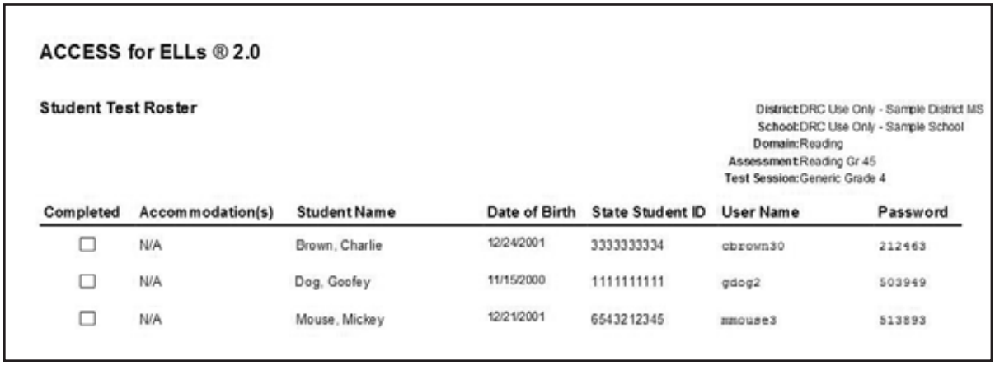
ACCESS for ELLs 2.0 Online: Student Test Tickets & Rosters
Notes:
In order to test, each student will need a unique test ticket that contains student specific login credentials he or she must use to access and begin the test. These tickets are secure materials and must be treated as such. The test tickets for a given test session are part of the Student Test Roster. The Student Test Roster summarizes test session information such as the test name, test session name, and the district and school.
These may be provided to you by your test coordinator or you may need to print these yourself from WIDA AMS depending on your school’s policy. We will discuss WIDA AMS later in this presentation. For detailed information about WIDA AMS see the WIDA AMS User Guide, available in the training course.

Slide 28
ACCESS for ELLs 2.0 Online: Additional Equipment
Headset:
Must have a microphone
Can be used for all domains (no audio in reading after directions)
Necessary for the Speaking domain to record student responses
Pencils for grades 1-3

Slide 29
ACCESS for ELLs 2.0 Online: Speaking Item Layout
Notes:
The sample Speaking test item on this slide is an approximation of what students will see on the screen. In the center, students will see a picture. To the left, they will see a virtual test administrator and a model student. The virtual test administrator will guide the student through the Speaking passages with directions and prompts. Next to the virtual test administrator, students will see a model student. The role of the model student is to provide examples of expected responses. As shown on this slide, the virtual test administrator will first ask a question to the model student.
After the model student has responded, students will be prompted to record their responses. Students will record their responses on the computer using a record button and will continue through the speaking items at their own pace. Because students’ voices will be recorded into the online test engine, all students will need headsets with microphones for the Speaking test. Students will be able to pause, if needed, while responding orally to the test items. Upon completion, the files will automatically be sent to DRC for scoring.

Slide 30
ACCESS for ELLs 2.0 Online: Microphone Check
Notes:
Because it is essential that each student Speaking response is correctly captured, after logging in and before beginning the Speaking test, students are required to do a microphone check. The microphone check is only done once prior to the student beginning the Speaking test. During the microphone check, the students will record their voice and listen to make sure it recorded. Refer to Test Administrator’s Script to assist students during the microphone check. Please refer to the Test Administrator Manual for more information.

Slide 31
ACCESS for ELLs 2.0 Online: Writing Domain Considerations
The different test delivery and response modes of the Writing test are designed to meet the needs of all learners:
Grade Level Cluster | Writing Test Format | Writing Response Mode
1-3 | Paper | Handwriting
4-12 | Online | Keyboarding default, with option to change to Handwriting for individual students (no mass assign)
Notes:
There are a few additional considerations that vary by grade and proficiency level for the Writing domain. To meet the needs of all learners, including those with limited keyboarding experience, the mode in which students take the Writing test will depend on their grades and proficiency levels. Students who handwrite their response to the Writing test (in a paper test booklet) are still considered Online testers because they will take all other domains Online. It is important to note that even students in grades 4–12 can handwrite their responses if this is a better option for them rather than keyboarding.
For all students in grades 1–3, the students will read the prompts as well as write their answers in paper booklets.
For Grades 4–12, there are two potential options for the Writing Test. Students may either keyboard their response as they are prompted on the screen, or they will follow along on the screen and write in a paper booklet when they are prompted. Please note that depending on the grade of the student and the state, the default response mode (Keyboarding or Handwriting) will vary.
For grades 4–5, each WIDA member state sets guidelines on whether the default setting will be keyboarding or handwriting. This means the WIDA Assessment Management System (WIDA AMS) will be set to this option for students unless the designated state or district staff changes the option to the other mode. The WIDA states’ pages will also include this state-specific information on this.
For all students in grade 6–12, the default response mode will be keyboarding. This means the test will be set up so that students keyboard their responses unless designated staff determine they should handwrite their responses in a booklet.
Should a student in grades 6–12 require a handwriting booklet rather than keyboarding their response, test coordinators will need to order these as Additional Materials in WIDA AMS. Please refer to the District and School Test Coordinator Manual for more information on this process.

Slide 32
Technology Requirements
Technology requirements for the online test are listed on the ACCESS for ELLs 2.0 Technology Page
Headphones are necessary for all domains
Headsets/headphones with built in microphones are an additional requirement for the Speaking test

Slide 33
WIDA AMS
Within the system, designated staff may:
Access any needed user guides or software downloads
Add students (Paper and Online- include all demo data)
Designate accommodations
Create test sessions
Print test tickets
Monitor student progress
View/print reports
Access student results (April)

Slide 34
Accommodations

Slide 35
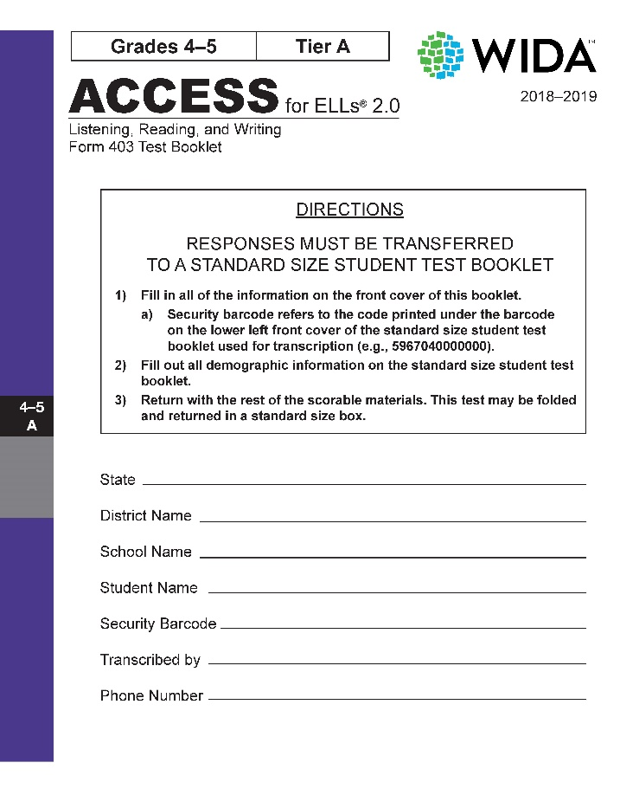
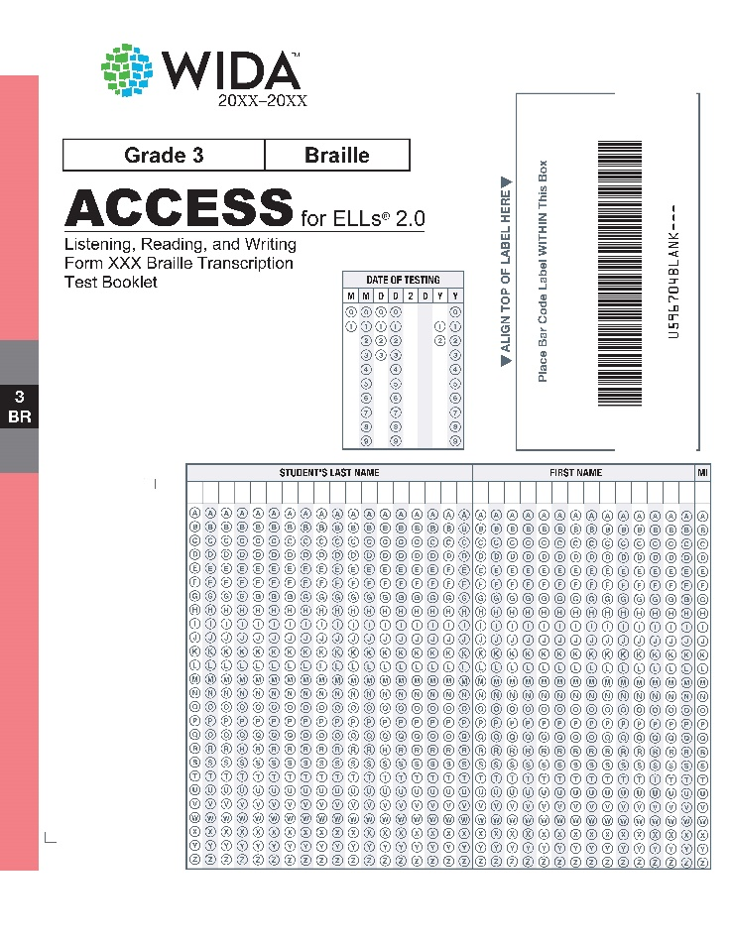
Accommodated Forms
Large Print
Braille

Slide 36
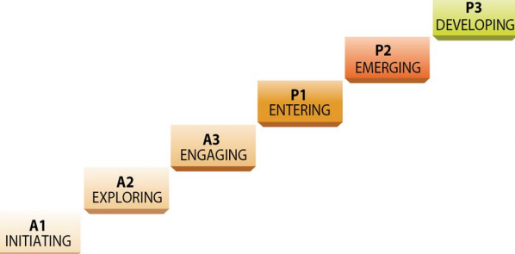
Alternate ACCESS for ELLs
Must have a Significant Cognitive Disability
Takes an Alternate State Content Assessment, documented in an IEP (alternate curriculum)
Notes:
Alternate ACCESS for ELLs is a separate assessment for ELLs in grades 1–12 with significant cognitive disabilities.
Alternate ACCESS for ELLs aligns with the WIDA Alternate English Language Proficiency levels. These levels were designed to expand upon Level P1 - Entering, by increasing the sensitivity of the measure for students who have significant cognitive disabilities. The alternate ELP levels give students a chance to demonstrate progress within Level P1. Information about participation criteria and test administration of the Alternate ACCESS test can be found in the Test Administration Manual.
This presentation will not go into detail about that assessment. Please see the Alternate ACCESS for ELLs presentation for more information about that assessment.

Slide 37
Alternate ACCESS for ELLs
Incorporated into Test
Accommodation
Extended testing of a test domain over multiple days
Extended Speaking test response time
Extended testing time within the school day
Human Reader
Manual control of item audio
Repeat item audio

Slide 38
Accommodation | Online | Paper | Domain
Braille | Na | X | L,R,W
Extended time of a domain over multiple days | X | X | L,R,S,W
Extended speaking test response time | X | X | L,R,S,W
Extended testing time within the school day | X | X | L,R,W
Human Reader | Na | X | L,S,W
Interpreter signs test directions | X | X | L,R,S,W
Large Print | X | X
Manual control of item audio | X | X | L,S,W
Non-school setting for administration | X | X | L,R,S,W
Repeat item audio | X | X | L,S,W
Scribe | X | X | L,R,W
Student responds with recording device | X | X | W
Word processor or external device | X | X | L,R,W

Slide 39
Accommodations
Prior to testing, indicate in test management system:
Manual control of item audio (MC)
Repeat item audio (RA)
Extended Speaking test response time (ES)
Must be pre-ordered
Braille forms
Large Print
Paper forms

Slide 40
Kindergarten ACCESS
Incorporated into Test
Accommodation
Extended testing of one domain over multiple days
Extended speaking test response time
Extended test time within one school day
Human reader
Manual control of item audio
Repeat item audio

Slide 41
Accommodations: Don’t do these things
WIDA explicitly states that the following are prohibited on any of the WIDA assessments:
Translating test items into a language other than English
Reading test items in a language other than English
Using a bilingual word-to-word dictionary
Responding to test questions in a language other than English

Slide 42
Materials

Slide 43
Receiving and storing
Schools will receive:
State-specific directions (goldenrod)
Plastic bags and ties for materials return (paper only)
Student labels (paper only)
Kindergarten kits
Test booklets (paper only)
Scripts
Testing manuals
School packing lists
School security checklists
RED= secure materials. Must be stored in secure, locked area. Use chain-of-custody documentation to track.

Slide 44
Returning materials
***ALL MATERIALS DUE TO CSI BY FEBRUARY 18, 2019***
See Section 5of TAM
Online schools:
ALL Kinder materials
ALL 1-3 Student writing booklets
1-3rd grade scripts
Paper schools:
BASICALLY EVERYTHING
Paper/online:
Student booklets sorted by tier/cluster and packaged in plastic bags (but not tied/sealed).

Slide 45
Training Requirements

Slide 46
The WIDA Secure Portal
Notes:
After you log-on, you’ll be granted access to the My Account and Secure Portal.
Click 1: Records of individuals’ certification quiz progress are available within the WIDA Secure Portal, and individuals can print a certificate of their completed training. All individual certifications from previous years will remain available in the WIDA Secure Portal as the tests have not changed, although the format of the training has been updated.
Click 2: All preparation materials for the ACCESS for ELLs 2.0 Operational Test are posted in the WIDA Secure Portal, including manuals, tutorials, webinars, and technology documentation. You can click on tile for the assessment you will administer: Kindergarten, Alternate, Paper-Based, Online. Within the ACCESS for ELLs 2.0 Training Course, information and web-based training modules for each assessment can be accessed. For Test Administrators who were certified to administer the ACCESS for ELLs 2.0 suite of assessments in previous years, information on recertification can be found within your state checklist. Even if you are not required to recertify this year, it is recommended that all Test Administrators review the training materials to prepare for the upcoming administration. We will review specific training information on the next slide.
Click 3: Test Coordinators are responsible for ensuring that all Test Administrators have completed applicable training components before giving ACCESS for ELLs 2.0. Please make sure your information within the My Account Info is correct. Most importantly, please make sure your email address, district, and school is correct. If not, please update and save.

Slide 47
SAC Training Requirements
Review the WIDA modules and the Test Administrator Manual
Train all staff who will be administering ACCESS on test administration and security
Ensure that all test administrators have taken and passed the appropriate quizzes

Slide 48
Test Administrator Training Requirements
View training tutorials for the tasks listed in state checklist.
Complete the knowledge checks at the end of each training tutorial
Complete the appropriate quizzes
I will be verifying that staff at each school have passed appropriate quizzes prior to the testing window
Notes:
Step 1: Test Administrators need to view training tutorials that are pertinent to the test administration. The training tutorials are short presentations designed to teach you about a specific aspect of training. Your state checklist should define these tasks.
Step 2: Complete the knowledge checks at the end of each training tutorial. These activities help Test Administrators review key concepts and prepare for the test administration quiz.
Step 3: Take appropriate Quizzes
Kindergarten ACCESS for ELLs
Grades 1–12 Online Administration
Grades 1–12 Paper Administration
Grades 1–5 Paper Speaking (locally scored)
Grades 6–12 Paper Speaking (locally scored)
Alternate ACCESS for ELLs
The next slides define the quizzes in more detail.

Slide 49
Technology Coordinator Training Requirements
Read DRC INSIGHT Technology User Guide
Complete Technology Readiness Checklist

Slide 50
Resources

Slide 51
Practice Test
https://wbte.drcedirect.com/WIDA/portals/wida

Slide 52
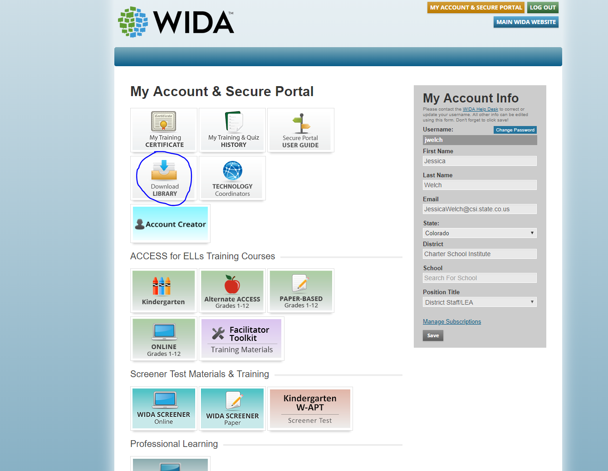

Slide 53
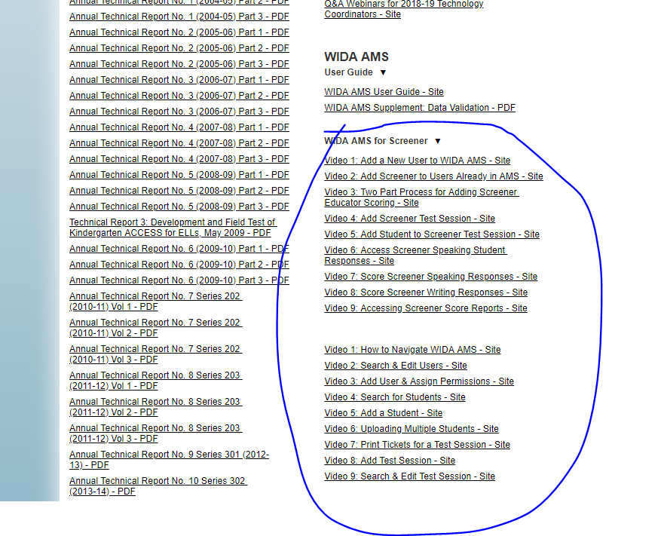

Slide 54
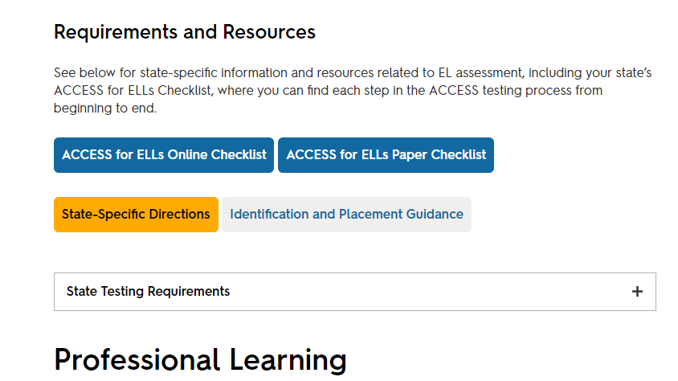
WIDA: Colorado Site

Slide 55
NEXT STEPS
Confirm test mode (paper or online)- email jessicawelch@csi.state.co.us; submit paper quantities (by cluster/tier)
Complete required ACCESS quizzes
Schedule time for staff training, and for TAs to complete required quizzes (monitor for completion)
Send training verification form to jessicawelch@csi.state.co.us

